Slide 1

Describing Corporate Bodies
Module 4
Module 4. Describing Corporate Bodies
1
Notes:
1
(Date of slide or last update given at the top of the notes for each slide)

Slide 2
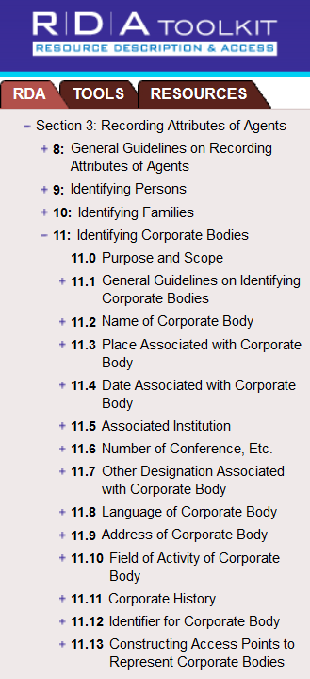
RDA Chapters 8
and 11
Module 4. Describing Corporate Bodies
Notes:
March 20, 2017
Guidelines for describing corporate bodies in authority records are found in RDA Chapters 8 and 11.
2

Slide 3
Definition of Corporate Body
(RDA 8.1.2)
The term corporate body refers to an organization or group of persons and/or organizations that is identified by a particular name and that acts, or may act, as a unit.
Module 4. Describing Corporate Bodies
3
Notes:
May 1, 2013
There is also a definition given at 11.0, which appears in a later slide.

Slide 4
MARC Coding
Most corporate bodies are coded in X10
  First indicator “1” for a jurisdiction name
  First indicator “2” for a name in direct order
Meetings, events, expeditions in direct order are coded in X11
  In RDA, first indicator is always “2”
As with other authority records, RDA records for corporate bodies are coded “z” in 008/10 (“Rules”) and “rda” in 040 subfield $e.
Module 4. Describing Corporate Bodies
4
Notes:
Updated August 12, 2019

Slide 5
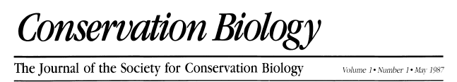
Serial
Society for Conservation Biology
Module 4. Describing Corporate Bodies
5
Notes:
December 13, 2016: removed MARC coding—premature
Here’s an example of a corporate body, taken from a serial.
5

Slide 6

Monograph
Museum of Fine Arts, Houston
Module 4. Describing Corporate Bodies
6
Notes:
December 13, 2016: removed MARC coding
Monographic example.
6

Slide 7

Kurt Weill Foundation for Music
Website
Module 4. Describing Corporate Bodies
7
Notes:
December 13, 2016: removed MARC coding
Here we see the name of a corporate body as presented on its website.
7

Slide 8
Corporate Bodies as Creators
Corporate bodies create records (archives)
Corporate bodies create serials (e.g. newsletters, quarterly reports)
Corporate bodies create monographs (e.g. manuals, proceedings, catalogs, directories)
Corporate bodies create Internet resources (e.g. company websites or blogs)
Module 4. Describing Corporate Bodies
8
Notes:
8
May 1, 2013
Like other entities, corporate bodies may serve as creators.
Some additional examples of corporate bodies as creators include some legal works (e.g. laws, treaties), the collective activity of a performing groups (e.g. sound recordings) and cartographic resources (maps, atlases).
They may also be contributors or subjects.

Slide 9
Corporate Bodies as Contributors, etc.
Corporate bodies can be contributors to an expression, or may be associated with manifestations and items as well, for example, as
  Performers Pointer Sisters Maroon 5
  Publishers Grove Press Bullfrog Books
  Owners UC San Diego Library J. Paul Getty Museum
Module 4. Describing Corporate Bodies
9
Notes:
9
Updated August 12, 2019: added examples
In addition to these, there are many other ways corporate bodies can be related to works, expressions, manifestations, or items.

Slide 10
Corporate Bodies as Subjects
Corporate bodies can also be subjects of works
610 20 Society for Conservation Biology.
610 10 United States. $b Department of Homeland Security.
611 20 Olympic Games $n (30th : $d 2012 : $c London, England)
Module 4. Describing Corporate Bodies
10
Notes:
May 1, 2013
MARC coding for subjects is the 6xx fields. Second indicator shows the subject vocabulary, 0 indicates that this form conforms to use with LCSH.
10

Slide 11
Transcription and Capitalization
8.5.2. Capitalization: follow Appendix A.2
8.5.4. Diacritical marks: record them as they appear; add them if it is certain that they are integral to the name but were omitted in the source
8.5.5. Retain hyphens if used by the body
8.5.6. Instructions about spacing between initials
8.5.7. Abbreviations. Follow the usage of the body
8.4. Language and script. NACO policy = Romanize vernacular scripts.
Module 4. Describing Corporate Bodies
11
Notes:
March 20, 2017: updated speaker notes
A.2.1
In general, capitalize the first word of each name; capitalize other words applying the guidelines given under A.10–A.55, as applicable to the language involved. For names with unusual capitalization, follow the capitalization of the commonly known form.
B.2
Use only the following abbreviations in names of agents and places:
a) those that are integral parts of the name (e.g., “Wm.”) if the agent or place* uses the abbreviation
b) certain names of larger places recorded as part of the name of another place
* There are some exceptions when dealing with geographic places. These are discussed in the Places module.

Slide 12
RDA 8.12. Source Consulted
Record in 670 field, or 3XX $u/$v
Always include one 670 for the work being cataloged
Others included if needed to justify information in the description
Suggested format:
  670 $a Title proper, date: $b location within source (data)
Module 4. Describing Corporate Bodies
12
Notes:
May 1, 2013
This is a LC-PCC core element.

Slide 13
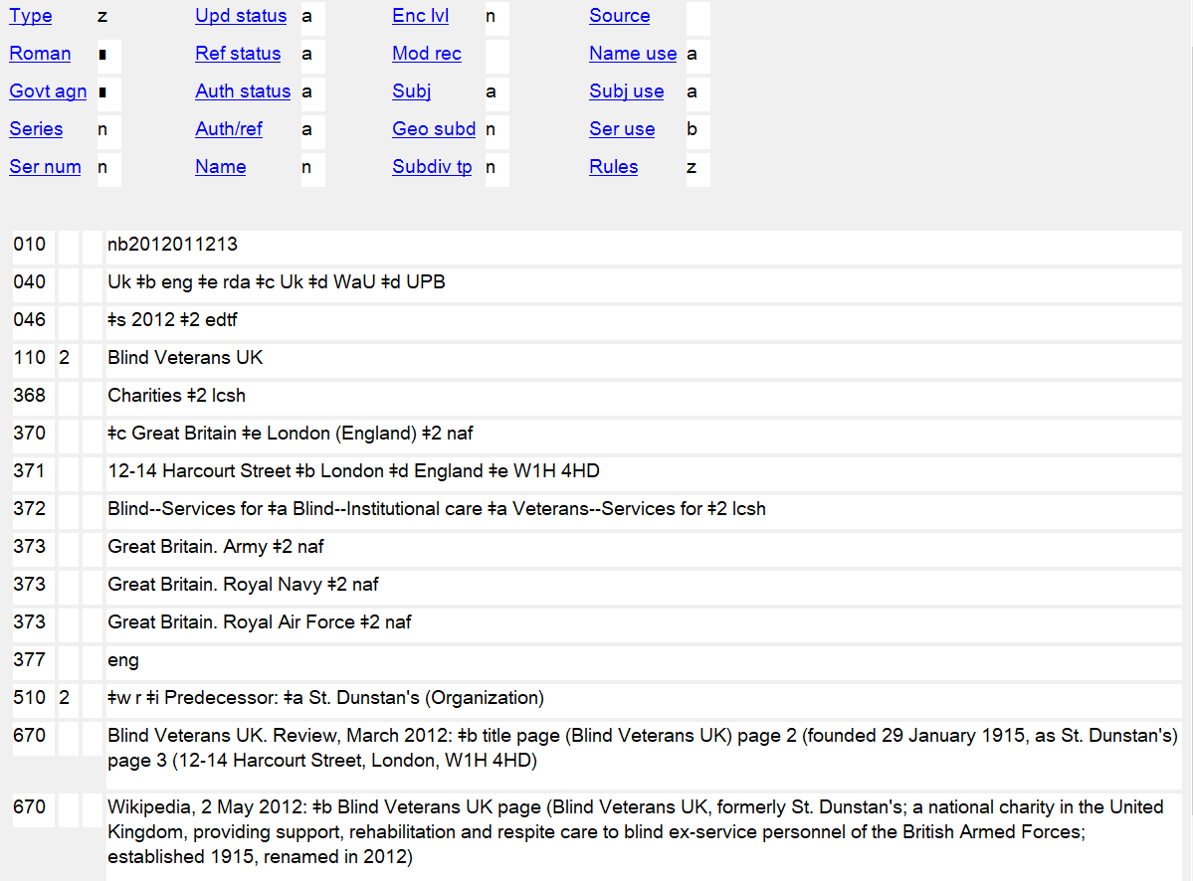
If updating record, change 046 $s to $q
Module 4. Describing Corporate Bodies
13
Notes:
13
August 23, 2023: updated to show use of subfield $q/$r in 046 field
December 4, 2019: replaced screenshot; added $i to the 510 field
The image above shows subfield $s used in the 046 field. As of August 2023, subfields $q and $r were approved for NACO use in the 046 field. If you were updating this record for another reason, you could change the subfield $s in the 046 field to subfield $q, as long as the 2012 date truly is the Establishment Date of the corporate body.
The MARC fields 008/10 (Rules) and 040 indicate that an authority record was constructed according to RDA.
Note: The preferred order of the placement of subfields in 040 is: $a $b $e $c. Some earlier records (from before the policy was set) in the LC/NAF appear with $e rda in different position.

Slide 14
Corporate Body Definition
RDA 11.0: Must be identified by a particular name, not a general description
Examples include associations, institutions, non-profit enterprises, governments, etc.
Also includes vessels and ad hoc events such as athletic contests, exhibitions, and festivals
Module 4. Describing Corporate Bodies
14
Notes:
14
Updated August 12, 2019: revised third bullet because vessels are not ad hoc events
First bullet: The name may actually be an acronym or initialism (RDA 11.2.2.5).
In order to meet the RDA definition of a corporate body:
1. It must be an organization or group;
2. It must be identified by a particular name; and
3. It must act or be capable of action.
Merriam-Webster dictionary definitions of “ad hoc”:
adverb: for the particular end or case at hand without consideration of wider application
adjective: 1. a: concerned with a particular end or purpose b: formed or used for specific or immediate problems or needs. 2. fashioned from whatever is immediately available: improvised

Slide 15
Identifying Corporate Bodies:
Core Elements (0.6.7)
Preferred name for the corporate body
Location of conference, etc.
Date of conference, etc.
Associated institution (core in certain cases)
Number of conference, etc.
Other designation (if body’s name does not convey the idea of a corporate body)
Identifier
Module 4. Describing Corporate Bodies
Notes:
March 20, 2017
Open to RDA 0.6.7, looking for core elements for the corporate body. CLICK THROUGH as people find them.
Remember “core” does not necessarily mean the information has to become part of the authorized access point. It simply means it must be recorded as part of the description if applicable and readily ascertainable.

Slide 16
Identifying Corporate Bodies:
Core if needed to distinguish (0.6.7)
Other place associated with the corporate body
Date of establishment
Date of termination
Period of activity of the corporate body
Associated institution
Other designation associated with the corporate body
Module 4. Describing Corporate Bodies
Notes:
November 25, 2015
Open to RDA 0.6.7, looking for core elements for the corporate body. CLICK THROUGH as people find them.

Slide 17
Ambiguous Entities
“Division of the World”
Heathrow Airport
Stanley Cup (Hockey)
Stock Exchange Tower (Montréal, Québec)
Juno Awards
Elmendorf Air Force
Base (Alaska)
Airports: H 405 Group 1 –
MARC 110, RDA
Sporting events: H 405 Group 1 –
MARC 111, RDA
Office buildings: H 405 Group 2 –
MARC 110, SHM
Awards: H 405 Group 2 –
MARC 150, SHM
Military installations (Active):
H 405 Group 1 –
MARC 151, RDA
DCM Z1 App. 1, SHM H 405
17
Notes:
March 20, 2017: reformatted, added animation, revised speaker notes
January 19, 2017: rewrote for SHM H 405
Note to Instructor: arrows and group from H 405 appear on click. May use as exercise: For each entity, should it be established in the Name Authority File or Subject Authority File? What MARC tag?
Ambiguous Entities “Division of the World”:
Type 1 = establish in NAF = Name Authority File, following RDA
Type 2 = establish in SAF = Subject Authority File, unless needed for descriptive cataloging (if so, establish in NAF); follow SHM with RDA
1) If you’ll remember, we discussed this documentation at the beginning of the class on Day 1. This is the piece of info that is actually found in about three different places. It’s important to remember to check this anytime you are establishing a type of corporate body that you don’t usually establish, because it can surprise you. Plus, there is the fact that this list has changed over time, so you can’t blindly trust the database to guide you correctly as to whether something should be a name or subject authority record.
2) Remember that if this document does not answer your question, feel free to consult with the Policy & Standards Division.
SHM H 405: https://www.loc.gov/aba/publications/FreeSHM/H0405.pdf

Slide 18
Exercise
What core elements can you identify about the Geological Society of America?
Module 4. Describing Corporate Bodies
18
Notes:
18
December 4, 2019: slide reference in speaker notes
Note to Instructor: Suggested answers are given on Slide 21, in the notes area, not on the slide. Trainees do not have answers for the exercise in their manuals.

Slide 19

Exercise
19
Notes:
May 1, 2013
19

Slide 20
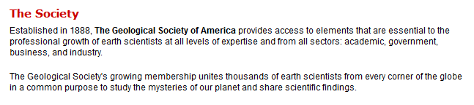
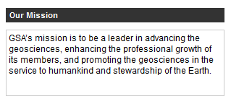
Exercise
Module 4. Describing Corporate Bodies
20
Notes:
May 1, 2013

Slide 21

Exercise
Module 4. Describing Corporate Bodies
21
Notes:
March 20, 2017
POSSIBLE ANSWERS:
** Preferred name: Geological Society of America
Variant name: GSA
* Date established: 1888
Field of activity: Geosciences
* Location: Boulder, CO
** = core element
* = core if needed to distinguish

Slide 22
Choosing and Recording the Preferred Name
The preferred name should be the commonly identified form of the name (RDA 11.2.2).
Forms found in preferred sources of information in manifestations associated with the corporate body (e.g. title pages of books) are assumed to be the commonly identified form.
Module 4. Describing Corporate Bodies
22
Notes:
22
March 20, 2017: updated to reflect current RDA language

Slide 23
Preferred Name Chosen from Preferred Sources
Museum of Fine Arts, Houston
Society for Conservation Biology
Module 4. Describing Corporate Bodies
23
Notes:
23
May 1, 2013

Slide 24
Preferred Name (RDA 11.2.2)
Record the name by which a corporate body is commonly identified directly unless its name belongs to one or more of the types listed under 11.2.2.14.
110 2_ Antioch University
110 2_ American Society for Engineering Education
110 2_ 5 Browns
110 2_ AFL-CIO
Module 4. Describing Corporate Bodies
24
Notes:
March 4, 2020
5 Browns: this is the name of a classical piano ensemble consisting of five siblings
AFL-CIO: the commonly known name may be an abbreviated form or an acronym
24

Slide 25
Preferred name (Initial Articles)
11.2.2.8. When recording the preferred name of a corporate body, include an initial article, if present.
  The Library Association
Alternative. Omit an initial article unless the name is to be accessed under the article
  Library Association
PCC practice: Omit initial articles unless the name is to be accessed under the article
  110 2_ Library Association
  but
  110 2_ Los Angeles String Orchestra
Module 4. Describing Corporate Bodies
25
Notes:
February 24, 2014
RDA was revised in 2012 to call for including initial articles if an entity uses them. This follows the principle of representation (describe the entity as it describes itself). However, realizing that systems still needed to drop initial articles in order to file correctly, an alternative was given to omit the initial article. PCC will follow the alternative.

Slide 26
Preferred name
(Terms indicating incorporation, etc.)
RDA 11.2.2.10. Omit an adjectival term indicating incorporation (Incorporated, Inc., e.V., Ltd., etc.) unless the term is needed to make clear that the name is that of a corporate body.
Note: “Company” or “Corporation” are not such terms.
    Bailey Motor Company not Bailey Motor Company Ltd.
    Merck & Co. not Merck & Co. Inc.
    United Airlines not United Airlines, Inc.
    Deutsche Gesellschaft für Akustik not Deutsche Gesellschaft für Akustik e.V.
But:
    Accepted, Inc.
    Seattle's Best Coffee, LLC
    James R. Murphy Incorporated
    Financial Skills Limited
26
Notes:
December 4, 2019: replaced Apple Computer, Inc. example with Accepted, Inc. because many catalogers feel that Apple Computer is so well known that it is clear as a corporate body
RDA 11.2.2.10 also instructs us to omit
b) a term indicating state ownership of a corporate body
c) a word or phrase, abbreviated or in full, indicating the type of incorporated entity (e.g., Aktiebolaget, Gesellschaft mit beschränkter Haftung, Kabushiki Kaisha, Società per azione).
These are not mentioned on the slide because they are rare in NACO work.
Note: the form of the term of incorporation is based on usage, so some names will have Inc. and others Incorporated, some Ltd. and others Limited.

Slide 27
Preferred name
(Terms indicating incorporation, etc.)
If: a term indicating incorporation, etc., is needed to make it clear that the name is that of a corporate body and the term occurs at the beginning of the name then: transpose the term to the end of the name.
Aerotransport, Aktiebolaget Forstprojektierung Potsdam, VEB
not Aktiebolaget Aerotransport not VEB Forstprojektierung Potsdam
If a name of corporate body in an Asian language includes an initial word or phrase indicating the private character of the body (e.g., Shiritsu, Si li), omit this initial word or phrase. Do not omit it if it is an integral part of the name.
Dong hai da xue Shiritsu Daigaku Toshokan Kyōkai
not Si li Dong hai da xue
Omit abbreviations occurring before the name of a ship (e.g., U.S.S., H.M.S.)
Arizona (Battleship) Swift (Sloop of war)
not U.S.S. Arizona not H.M.S. Swift
27
Notes:
October 7, 2024: new slide
Shiritsu (私立) means “private” in Japanese. Shiritsu Daigaku Toshokan Kyōkai means “Association of Private University Libraries” so in this instance “Shiritsu” is an integral part of the name.

Slide 28
Exercise
Record the preferred names for the four corporate bodies we have looked at so far on your work forms
Module 4. Describing Corporate Bodies
28
Notes:
Updated: Feb. 24, 2014
Instructor’s note: Refer trainees back to slides 5, 6, 7 and 21 for the information needed to complete this exercise.
Suggested answers are given below. Trainees do not have answers for the exercise in their manuals.
ANSWERS:
110 2 $a Society for Conservation Biology
110 2_ $a Museum of Fine Arts, Houston
110 2_ $a Kurt Weill Foundation for Music
110 2_ $a Geological Society of America
28

Slide 29
Preferred Name (RDA 11.2.2)
Different forms of the same name (11.2.2.5)
  If variant forms of the name are found in manifestations associated with the body, choose the name as it appears in the preferred sources of information.
  If variant names appear in the preferred source of information, choose the name that is presented formally as the preferred name.
Module 4. Describing Corporate Bodies
29
Notes:
March 20, 2017: updated to reflect current RDA language
The RDA glossary defines the preferred name for the corporate body as:
The name or form of name chosen to identify a corporate body.
The preferred name is used as the basis for the authorized access point representing that body.

Slide 30
Preferred Name (RDA 11.2.2)
Different forms of the same name, continued (11.2.2.5)
  If no name is presented formally, choose the most commonly found form of name.
  If there is no most commonly found form of the name, choose a brief form of the name.
Module 4. Describing Corporate Bodies
30
Notes:
February 24, 2014
The brief form may be an initialism or an acronym. The brief form must be sufficiently specific to differentiate the body from others with the same or similar brief names.

Slide 31
Preferred Name (RDA 11.2.2)
Language of the name (11.2.2.5.2)
  If the name appears in different languages, choose the form in the official language of the body as the preferred name.
LC-PCC PS: If there is more than one official language and one of these is English, choose the form in English as the preferred name.
Module 4. Describing Corporate Bodies
31
Notes:
May 1, 2013

Slide 32
Preferred Name (RDA 11.2.2)
International bodies (11.2.2.5.3)
  If the name of an international body appears in the language preferred by the agency creating the data in manifestations associated with it, choose that form as the preferred name.
LC-PCC PS: If the name of an international body appears in English on resources associated with it, choose that form as the preferred name.
Module 4. Describing Corporate Bodies
32
Notes:
August 12, 2019: added some examples in notes
Some examples:
United Nations, not Nations Unies, nor Naciones Unidas, nor Nações Unidas, nor Vereinigte Nationen,
nor Lian he guo, etc.
International Sauna Society, not Internationale Sauna-Gesellschaft, nor Société international de sauna
International Botanical Congress, not Congreso Internacional de Botánica, nor Congrès international
de botanique, nor Mezhdunarodnyĭ botanicheskiĭ congress
World Chess Federation, not Fédération internationale des échecs, nor Federación Internacional de
Ajedrez, nor Världsschackförbundet
Pan American Games, not Juegos Panamericanos, nor Jogos Pan-Americanos, nor Pan-Amerikaanse Spelen,
nor Jeux panaméricains

Slide 33
Preferred Name (RDA 11.2.2)
Change of name (11.2.2.6)
If a corporate body changes its name, create a new record for the new name. Use the earlier form with resources associated with it; and the later form with resources associated with it.
Loft, Inc. → Pepsi-Cola Company → PepsiCo
Module 4. Describing Corporate Bodies
33
Notes:
May 1, 2013
11.2.2.6
If the name of a corporate body has changed (including changes from one language to another), choose the earlier name as the preferred name for use with resources associated with the earlier name. Choose the later name as the preferred name for use with resources associated with the later name.
LC-PCC PS for 11.2.2.6 says to treat minor differences in names as variants names, in the absence of “explicit evidence that a true name change has taken place.” Minor differences include: spelled out forms vs. acronyms; changes in prepositions, articles or conjunctions; a change in punctuation.
Historical note: Loft, Inc. was incorporated in 1919. In 1941 it changed its name to Pepsi-Cola Company, and in 1965 to PepsiCo.
Subject treatment: SHM H 460 instructs:
“Assign the heading for the name used by the body during the latest period covered by the work being cataloged.” However: “If an earlier name is prominently featured in the work being cataloged, assign the heading for the earlier name as well.”
33

Slide 34
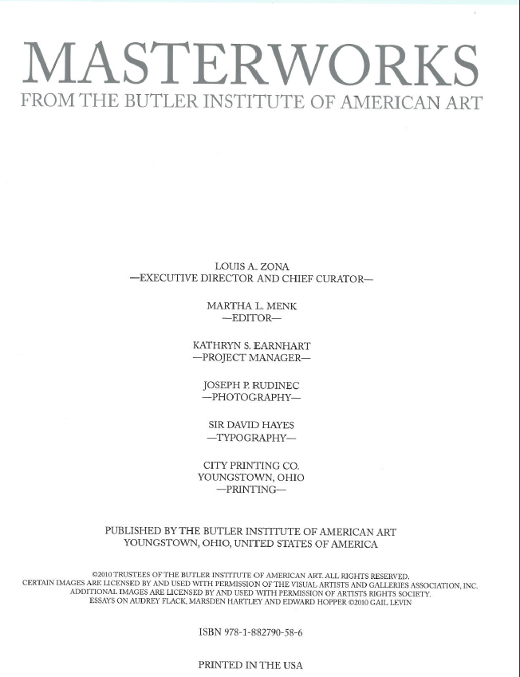

Exercise
Module 4. Describing Corporate Bodies
34
Notes:
May 1, 2013
Exercise.
Note to Instructor: Answers below. Trainees do not have the answers in their manuals.
Title page and back cover.
What attributes about the corporate body are found here?
Answers:
Preferred name.
Location

Slide 35
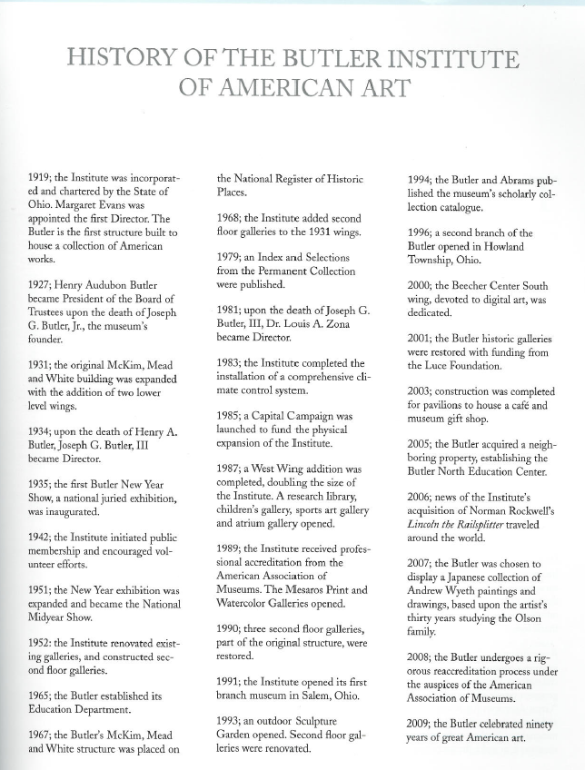
Exercise
Page 9
Module 4. Describing Corporate Bodies
35
Notes:
May 1, 2013
What attributes of the corporate body do we find on this page?
Note to Instructor: Suggested answers are given below. Trainees do not have answers for the exercise in their manuals.
Answer:
Date of incorporation: 1919.
Subordinate body: Butler North Education Center

Slide 36
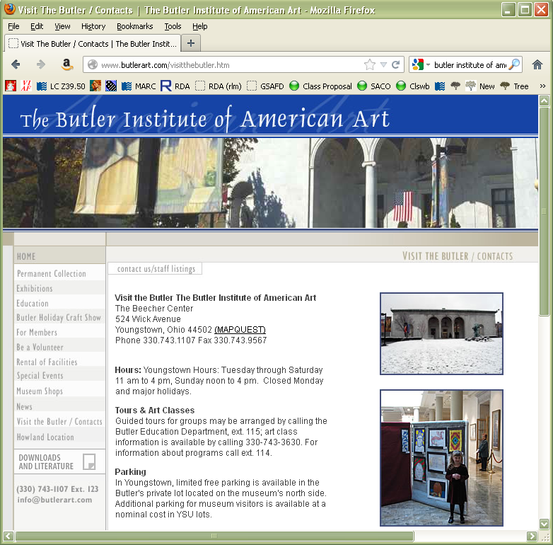
^{Exercise}
36
Notes:
May 1, 2013
Other attributes?
Note to Instructor: Suggested answers are given below. Trainees do not have answers for the exercise in their manuals.
Answer:
Address: 524 Wick Avenue, Youngstown, Ohio 44502
E-mail: info@butlerart.com

Slide 37
Preferred Names for Subordinate and Related Bodies
RDA 11.2.2.13-14
Preferred name recorded directly is the default, unless…
… the criteria listed at 11.2.2.14 are met
Module 4. Describing Corporate Bodies
37
Notes:
February 24, 2014
In AACR2, as well as the earliest releases of RDA, there was a difference in the treatment of governmental and non-governmental bodies regarding subordinate entry. Those differences are no longer made. *
Although most preferred forms are recorded directly, there are several specific instances in which corporate bodies should be recorded subordinately.
11.2.2.14 provides a list of criteria against which you need to test any new name to see if meets any of the criteria for subordinate recording before saying, yes, it should be recorded directly. These are the rules that you need to constantly recheck when setting up corporate bodies.
* LC-PCC PS 11.2.2.14.6 makes an exception for subordinate U.S. government bodies when one body uses “United States” and another uses “U.S.”
37

Slide 38
Subordinate and Related Bodies
Usage and preferred names may not necessarily match
Usage: Agricultural Experiment Station of Auburn University
Preferred name: Auburn University. Agricultural Experiment Station
Module 4. Describing Corporate Bodies
38
Notes:
May 1, 2013
What appears on the source does matter, but will not always determine the form of the preferred name.
38

Slide 39
RDA 11.2.2.14.1
A name containing a term that by definition implies that the body is part of another (e.g., Department, Division, Section, Branch).
110 2_ Harvard University. $b Department of Physics
110 1_ Hawaii. $b Department of Human Resources Development
Module 4. Describing Corporate Bodies
39
Notes:
May 1, 2013
39
39

Slide 40
RDA 11.2.2.14.2
A name containing a term that normally implies administrative subordination (e.g., Committee, Commission).
110 2_ Medical Library Association. $b
Committee on Continuing Education
110 1_ San Francisco (Calif.). $b Art Commission
Apply only if the name of the higher body is required for the identification of the subordinate body.
but 110 2_ Honolulu Committee on Aging
not 110 1_ Honolulu (Hawaii). $b Committee on Aging
Module 4. Describing Corporate Bodies
40
Notes:
March 29, 2017: corrected indicator
The LC-PCC PS lists additional terms that may imply administrative subordination for corporate bodies whose official language is English, French, or Spanish, e.g. board, bureau, office, panel, etc.
N.B. This rule only applies when the name of the higher body is needed to identify the subordinate body, e.g. “Statistical Committee,” “Personnel Commission.”
40
40

Slide 41
RDA 11.2.2.14.3
A name that is general in nature (e.g. contains neither distinctive proper nouns or adjectives, nor subject words) or that does no more than indicate a geographic, chronological, or numbered or lettered subdivision of a parent body
110 1_ United States. $b National Labor Relations Board. $b Library
110 2_ Society of Biblical Literature. $b Annual Meeting
Module 4. Describing Corporate Bodies
41
Notes:
September 17, 2018: reformatted slide
Examples of names that are general in nature include: Technical Information Library, Friends of the Library, Annual Meeting.
41
41

Slide 42
RDA 11.2.2.14.3
A name that is general in nature (e.g. contains neither distinctive proper nouns or adjectives, nor subject words) or that does no more than indicate a geographic, chronological, or numbered or lettered subdivision of a parent body
110 2_ U.S. Fish and Wildlife Service. $b Region 6
110 1_ United States. $b National Weather Service. $b Western Region
110 2_ University of Virginia. $b Class of 2008
Module 4. Describing Corporate Bodies
42
Notes:
December 4, 2019
42
42

Slide 43

RDA 11.2.2.14.4
A name that does not convey the idea of a corporate body and does not contain the name of the higher body.
110 2_ Tufts University. $b Human Resources
110 1_ Prince Edward Island. $b Tourism Marketing Branch. $b Research and Evaluation
but 110 2_ California Records & Information Management
not 110 1_ California. $b Records & Information Management
Module 4. Describing Corporate Bodies
43
Notes:
May 1, 2013
Additional examples of names that would fail this test and consequently be recorded directly include:
Andhra Pradesh Tourism
Arkansas State Parks
BC Fisheries
Cornell Legal Aid
Duke Human Resources
Geoscience Australia
National Parks and Wildlife SA [SA is abbreviation for the state of South Australia]
Nova Scotia Archives and Records Management
Oklahoma Agritourism
Tufts Lesbian, Gay, and Bisexual Community
Ulster County Tourism
43
43

Slide 44

RDA 11.2.2.14.5
A name of a university faculty, school, college, institute, laboratory, etc., that simply indicates a particular field of study.
110 2_ Rutgers University. $b Center for Latin American Studies
Module 4. Describing Corporate Bodies
44
Notes:
May 1, 2013
44
44

Slide 45
RDA 11.2.2.14.5
… but
110 2_ Rutgers Center for Innovative Printmaking
110 2_ Rutgers Accounting Research Center
110 2_ Rutgers Medical School
110 2_ Rutgers Oral History Archives
Module 4. Describing Corporate Bodies
45
Notes:
August 12, 2019: added a few additional examples
The name of these bodies include more than just the field of study, so RDA 11.2.2.14.5 would not apply. None of these are included in RDA 11.2.2.14.6 because they do not include the entire name of the higher body (i.e. Rutgers University).
Other examples of Rutgers units that are entered directly:
110 2_ Alan M. Voorhees Transportation Center
110 2_ Bloustein Center for Survey Research
110 2_ Douglass College
110 2_ Robert Wood Johnson Medical School
110 2_ Waksman Institute of Microbiology
45

Slide 46
RDA 11.2.2.14.6
A name of a non-governmental body whose name includes the entire name of the higher or related body
Friends of All Saints Church
Brixworth
Northamptonshire
Module 4. Describing Corporate Bodies
46
Notes:
May 1, 2013
This type only applies to non-governmental bodies.
RDA 11.2.2.14.6
Distinguish cases in which the subordinate body’s name includes the names of higher bodies from cases in which the names of higher bodies appear only in association with the subordinate body’s name.
46

Slide 47
RDA 11.2.2.14.6
Name: Friends of All Saints’ Church
Preferred name of higher or related body:
All Saints’ Church
AAP of higher or related body:
All Saints’ Church (Brixworth, England)
Authorized access point:
110 2_ All Saints’ Church (Brixworth, England). $b Friends
Module 4. Describing Corporate Bodies
47
Notes:
March 5, 2019: added conference example to names that fail the test and added the entire names of the higher body
LC-PCC PS: The term "includes" in the instruction applies to any linguistic relationship between the name of the body and its parent (higher or related) body, not just to those shown in the examples for the instruction. The phrase "entire name" is the preferred name of the higher or related body, not necessarily the complete authorized access point of that body. For example, disregard additions to the preferred name or the fact that the higher or related body may be subordinate to another body.
Names that fail this test and would be recorded directly include:
BBC Symphony Orchestra (entire name of the higher body = British Broadcasting Corporation)
CU-Boulder Alumni Association (entire name of the higher body = University of Colorado Boulder)
Friends of the Corcoran (entire name of the higher body = Corcoran Gallery of Art)
Annual Meeting of FOIM (entire name of the higher body = Fellowship of Indian Missiologists)
If the authorized access point for the higher or related body includes an addition to the name, include that: in this example, the geographic location is added.
47
47

Slide 48
RDA 11.2.2.14.6
Name: Annual Meeting of the International Whaling Commission
Preferred name of higher or related body:
International Whaling Commission
Authorized access point:
110 2_ International Whaling Commission. $b Annual Meeting
Module 4. Describing Corporate Bodies
48
Notes:
February 24, 2014
48
48

Slide 49
RDA 11.2.2.14.6
Names that fail the requirements of this instruction:
BBC Symphony Orchestra
Higher body: British Broadcasting Corporation
CU-Boulder Alumni Association
Related body: University of Colorado Boulder
Annual Meeting of FOIM
Higher body: Fellowship of Indian Missiologists
Module 4. Describing Corporate Bodies
49
Notes:
March 5, 2019: corrected form of University of Colorado Boulder; added speaker note, added third example
In the second example, the University is a related body, not a higher body. Alumni associations are generally not controlled by their universities. They fit the “related” part of “higher or related body”.
49
49

Slide 50
Other Types
110 1_ United States. $b General Services Administration. $b Region 5
110 1_ Vanuatu. $b Ministry of Internal Affairs and Social Services
110 1_ Boring (Or.). $b City Council
110 1_ Ontario. $b High Court of Justice
Module 4. Describing Corporate Bodies
50
Notes:
August 12, 2019: corrected typo in notes
Other types of names that are recorded subordinately include agencies with names that are general in nature; ministries or major executive agencies with no parent agency; legislative bodies; courts, and a principal service of the armed forces of a government.
110 1_ United States. $b General Services Administration. $b Region 5 (Agency with a name that is general in nature. 11.2.2.14.3)
110 1_ Vanuatu. $b Ministry of Internal Affairs and Social Services (Ministry or similar executive agency. 11.2.2.14.7)
110 1_ Boring (Or.). $b City Council (Legislative body. RDA 11.2.2.14.9, see also RDA 11.2.2.19)
110 1_ Ontario. $b High Court of Justice (Court. RDA 11.2.2.14.11, see also RDA 11.2.2.21)
50

Slide 51
Other Types
110 1_ Germany. $b Heer
110 1_ Idaho. $b Governor
110 1_ United States. $b Consulate (Asunción, Paraguay)
Module 4. Describing Corporate Bodies
51
Notes:
March 20, 2017: updated speaker notes.
110 1_ Germany. $b Heer (Armed forces. RDA 1.2.2.14.12, see also RDA 11.2.2.22)
110 1_ Idaho. $b Governor (Head of state. RDA 11.2.2.14.8, see also RDA 11.2.2.18) – Example included on next few slides.
110 1_ United States. $b Consulate (Asunción, Paraguay) (Embassies, Consulates, etc. RDA 11.2.2.14.13, see also RDA 11.2.2.23)
51

Slide 52
Government Officials
(RDA 11.2.2.18)
Record the title of heads of state, heads of governments, etc. as a subdivision of the jurisdiction. Record the title in English.
110 1_ Indonesia. $b President
110 1_ France. $b Prime Minister
110 1_ Chiapas (Mexico). $b Governor
110 1_ Moscow (Russia). $b Mayor
Module 4. Describing Corporate Bodies
52
Notes:
December 4, 2019: added two more examples at other jurisdiction levels
March 5, 2019: changed second example Swaziland to France to show point that the English form is now chosen as the preferred form for the title
This category includes a sovereign, president, other head of state, governor, head of government, or chief executive who is acting in an official capacity.
LC-PCC PS to 11.2.2.18.1 instructs to record the title in English.
Recording all these in English represents a change from AACR2 and RDA as first published--in 2012 “record the title in a language preferred by the agency” was made applicable to both heads of state and heads of government; previously it was only applicable to heads of state. The titles of heads of government were recorded in their own language, e.g. the current “France. Prime Minister” was, under the previous instruction, “France. Premier ministre”.
Examples of English terms for heads of government: Prime Minister, Chancellor, Federal Chancellor, Chief Minister, Chief Executive, First Minister, Premier, Governor, Mayor
Examples of English terms for heads of state: President, Sovereign, Emperor, Governor, Governor-General, Sultan, Emir, Grand Duke
52

Slide 53
Government Officials
(RDA 11.2.2.18)
When identifying a specific incumbent to the office, add
Inclusive years of the reign or incumbency
Name of the person in a brief form
110 1_ Indonesia. $b President (1949-1967 : Soekarno)
110 1_ Tucson (Ariz.). $b Mayor (1951-1955 : Emery)
Module 4. Describing Corporate Bodies
53
Notes:
March 20, 2017
53

Slide 54
Government Officials
(RDA 11.2.2.18)
Subj n Subj use b
110 1_ United States. $b President (1993-2001 : Clinton)
500 1_ $w r $i Chief executive: $a Clinton, Bill, $d 1946-
667 SUBJECT USAGE: This name is not valid for use as a subject. Works about this person are entered under Clinton, Bill, 1946-
Module 4. Describing Corporate Bodies
54
Notes:
March 5, 2019: added note about requirement for recording the reciprocal relationship in the other NAR
It may be necessary to create an authorized access point for the personal name as well. For subject cataloging, only the personal name form may be used. A see also reference is given to the other form. Add a subject usage note in field 667. The fixed fields for subject heading system and subject usage are also coded to indicate that this form is not used in subject cataloging.
The relationship designator comes from Appendix K.2.3.
The reciprocal relationship must also be made (e.g., a 510 for United States. $b President (1993-2001 : Clinton) should be recorded in the NAR for Clinton, Bill, 1946- ). See PCC Guidelines for the Application of Relationship Designators in NACO Authority Records, Guideline 11.
54

Slide 55
Religious Officials (RDA 11.2.2.26)
Subj n Subj use b
110 2_ Catholic Church. $b Pope (2005-2013 : Benedict XVI)
500 1_ $w r $i Chief executive: $a Benedict $b XVI, $c Pope, $d 1927-
667 SUBJECT USAGE: This name is not valid for use as a subject. Works about this person are entered under Benedict XVI, Pope, 1927-
Module 4. Describing Corporate Bodies
55
Notes:
March 5, 2019: added note about requirement for recording the reciprocal relationship in the other NAR
Religious officials, including popes, are treated in a similar manner.
The reciprocal relationship must also be made (e.g., a 510 for Catholic Church. $b Pope (2005-2013 : Benedict XVI) should be recorded in the NAR for Benedict XVI, Pope, 1927- ). See PCC Guidelines for the Application of Relationship Designators in NACO Authority Records, Guideline 11.
55

Slide 56
Direct or Indirect Subdivision
(RDA 11.2.2.15)
Intervening hierarchies
Record the name of the body as a subdivision of the lowest organizational unit in the hierarchy that is recorded directly under its own name
Omit intervening units in the hierarchy, unless the name of the subordinate or related body has been, or is likely to be, used by another body in the same organization
Module 4. Describing Corporate Bodies
56
Notes:
May 1, 2013
What appears on the source does matter, but will not always determine the form of the preferred name.
56

Slide 57
Direct or Indirect Subdivision
(RDA 11.2.2.15)
Intervening Hierarchies
Hierarchy: American Bar Association - Section of Business Law - Committee on Nonprofit Corporations
110 2_ American Bar Association. $b Committee on Nonprofit Corporations
Module 4. Describing Corporate Bodies
57
Notes:
May 1, 2013
So, we’ve now covered the 6 types of subordinate bodies.
But once we’ve decided it must be subordinate, we need to look at that organization chart, if at all possible. How many levels are in the hierarchy? How many of those levels must be included in the heading? Remember the basic idea, only enough needed for identification.
The basic idea will be to only put the minimum number of levels of subordination in a heading. You do not want to include the entire organization chart if you don’t have to.
NOTE: Although we have not mentioned variant names, note that there will be a variant name with multiple levels.
57

Slide 58
Exercise: Corporate Body Recorded Subordinately or Not?
Library of Congress
  110 2_ Library of Congress (none of types in RDA 11.2.2.14)
Student Society for Ancient Studies [at Brigham Young University]
  110 2_ Student Society for Ancient Studies (none of types in 11.2.2.14)
Advanced Plans Directorate [at Aerospace Corporation]
  110 2_ Aerospace Corporation. $b Advanced Plans Directorate (RDA 11.2.2.14.2)
Corporate Grants [at Apple Computer, Inc.]
  110 2_ Apple Computer, Inc. $b Corporate Grants (RDA 11.2.2.14.4)
58
Notes:
December 4, 2019: added explanation for first two examples in the slide
Look at LC-PCC PS 11.2.2.14.2 for list of words (Directorate is found there).
Note to Instructor: Answers appear on click. PDFs of slides will have the answers already present, so remind them to look at screen, not handout.

Slide 59
Exercise: Corporate Body Recorded Subordinately or Not?
The Gallery [at Scarborough College]
  110 2_ Scarborough College. $b Gallery (RDA 11.2.2.14.3)
Centre for Medieval Studies [at University of Toronto]
  110 2_ University of Toronto. $b Centre for Medieval Studies (RDA 11.2.2.14.5)
Scripps College Press
  110 2_ Scripps College. $b Press (RDA 11.2.2.14.6)
U.S. Department of Defense
  110 1_ United States. $b Department of Defense (RDA 11.2.2.14.1)
Notes:
December 13, 2016: added RDA instruction number to last example
Note to Instructor: Answers appear on click. PDFs of slides will have the answers already present, so remind them to look at screen, not handout.

Slide 60
Exercise: Corporate Body Recorded Subordinately or Not?
Allegheny County Planning Commission
110 2_ Allegheny County Planning Commission
  (Not RDA 11.2.2.14.2 because name of the higher body is not required for the identification of the subordinate body)
Sandy City Council
  110 1_ Sandy (Utah). $b City Council (RDA 11.2.2.14.9)
Canadian Embassy/Ambassade du Canada, Washington, DC
  110 1_ Canada. $b Embassy (U.S.) (RDA 11.2.2.14.13)
Module 4. Describing Corporate Bodies
60
Notes:
August 12, 2019: replaced Honolulu example because it was identical to example on slide 39
Note to Instructor: Answers appear on click. PDFs of slides will have the answers already present, so remind them to look at screen, not handout.
Allegheny County Planning Commission is not RDA 11.2.2.14.2 (an agency with a name containing a word that normally implies administrative subordination) because the instruction goes on to say:
Apply only if the name of the higher body is required for the identification of the subordinate body.

Slide 61
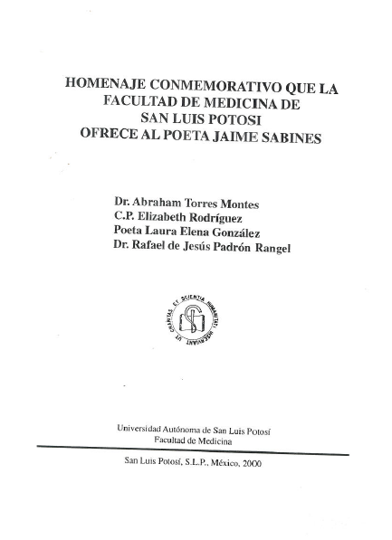
Module 4. Describing Corporate Bodies
61
Notes:
February 24, 2014
A title page from a resource associated with the Facultad de Medicina of Universidad Autónoma de San Luis Potosí. How does the name appear? “Facultad de Medicina” and “Facultad de Medicina de San Luis Potosí.” Is this a subordinate body? Yes. Should we record it under its own name or subordinately? Go through the types in 11.2.2.14. This is 11.2.2.14.5.

Slide 62
Subordinate Bodies
11.2.2.14. Record the name of a subordinate or related body as a subdivision of the authorized access point representing the higher or related body if its name belongs to one or more of the types listed at RDA 11.2.2.14.1-11.2.2.14.6.
  110 2_ Universidad Autónoma de San Luis Potosí. $b Facultad de Medicina
Module 4. Describing Corporate Bodies
62
Notes:
March 20, 2017
NACO policy requires us to establish all levels in the hierarchy. So if the University hadn’t yet been established, it would have to be established before the Facultad de Medicina can be established. Also note that there is a variant, “Facultad de Medicina de San Luis Potosí.” Record that as is in a 410.

Slide 63
Things to Remember
Division of the World (DCM Z1 Appendix 1 and SHM H 405)
Record directly, unless rules of subordination apply
Use the form in the official language of the body
Module 4. Describing Corporate Bodies
63
Notes:
May 1, 2013
Base preferred names on the forms found in sources of body's own publications in its own language.
If an international body includes an English form in its publications, use that form.

Slide 64
Attributes of Corporate Bodies:
Dates
Several types of date
  Date of a conference, etc. (11.4.2)
  Date of establishment (11.4.3)
  Date of termination (11.4.4)
  Period of activity (11.4.5)
The date of conference element is core. If it is known it should be recorded as an element
  This does not necessarily mean it will be recorded as part of the access point
Other known dates may also be recorded
Module 4. Describing Corporate Bodies
64
Notes:
November 25, 2015
Go to 11.4. Read together.
NOTE: PCC has not yet implemented the period of activity element.

Slide 65
Attributes of Corporate Bodies: Dates
Basic instructions
  Known date: 2005
  Approximate date: approximately 1953
  Ranges of dates may also be recorded
Module 4. Describing Corporate Bodies
65
Notes:
Updated: October 6, 2020 to remove two examples since they are not defined in RDA
November 25, 2015

Slide 66
Attributes of Corporate Bodies: Dates
Except for century dates, this element is recorded in MARC 046 in the EDTF format YYYY-MM-DD or YYYY-MM or YYYY (with $2 edtf).
EDTF format: http://www.loc.gov/standards/datetime/. See this website for more complex situations.
Century dates do not follow the EDTF format. Simply record the first two digits of the century (e.g. “19” = all dates beginning with “19” = 20th century) with no $2.
MARC
$q - Date of establishment $s - Start of period of activity
$r - Date of termination $t - End of period of activity
Module 4. Describing Corporate Bodies
66
Notes:
August 23, 2023: updated slide to show use of subfield $q/$r in 046 field
December 4, 2019: added note about coding period of activity dates for corporate bodies
December 12, 2016: moved implementation information to slide (since participants probably do not have the notes)
GO TO MARC 046 field

Slide 67
Attributes of Corporate Bodies: Dates
For a company founded in 1960
046 $q 1960 $2 edtf
For a musical group that started in 1960 and broke up in 1970
046 $q 1960 $r 1970 $2 edtf
Date of establishment: $q
Date of termination: $r
Module 4. Describing Corporate Bodies
67
Notes:
August 23, 2023: updated to show use of subfield $q/$r in 046 field
December 13, 2016: moved implementation note to slide

Slide 68
Attributes of Corporate Bodies: Dates
Expressing unusual dates in EDTF
  Approximately 1902 046 $q 1902~ $2 edtf
  BC dates begin with a negative sign, and are one year off (because there was no year 0)
    147 B.C. 046 $q -0146 $2 edtf
  See https://www.loc.gov/standards/datetime/
Module 4. Describing Corporate Bodies
68
Notes:
August 23, 2023: updated to show use of subfield $q/$r in 046 field
Updated: October 6, 2020 to remove one example since it is not defined in RDA
December 13, 2016: moved implementation note to slide
BC dates are one year off because there was no year “0”.
* NOTE: PCC has not yet implemented $q and $r. DO NOT USE until implementation. Until then, $s and $t stand for date of establishment and date of termination.

Slide 69
Date Associated with the Corporate Body (RDA 11.4)
010 n 93079938
046 $q 1178 $r 1536 $2 edtf
110 1_ England. $b Court of Common Pleas
510 1_ $w r $i Successor: $a England and Wales. $b Court of Common Pleas
010 n 84134093
046 $q 1536 $r 1707 $2 edtf
110 1_ England and Wales. $b Court of Common Pleas
510 1_ $w r $i Predecessor: $a England. $b Court of Common Pleas
510 1_ $w r $i Successor: $a Great Britain. $b Court of Common Pleas
Module 4. Describing Corporate Bodies
69
Notes:
August 23, 2023: updated to show use of subfield $q/$r in 046 field
September 17, 2018: moved $w to beginning of 510 fields
The records in this and the next slide show how dates in an authority record can be very helpful in identifying an entity.

Slide 70
Date Associated with the Corporate Body (RDA 11.4)
010 n 50072690
046 $q 1707 $r 1875 $2 edtf
110 1_ Great Britain. $b Court of Common Pleas
510 1_ $w r $i Successor: $a Great Britain. $b High Court of Justice. $b Common Pleas Division
510 1_ $w r $i Predecessor: $a England and Wales. $b Court of Common Pleas
Module 4. Describing Corporate Bodies
70
Notes:
August 23, 2023: updated to show use of subfield $q/$r in 046 field
September 17, 2018: moved $w to beginning of 510 fields

Slide 71
Place Associated with the Corporate Body (RDA 11.3)
The Place Associated with the Corporate body element is a core element for conferences and for other corporate bodies when needed to distinguish between bodies with the same name
Record in 370 field
  $e Hamden (Conn.) $2 naf
  370 $e Salt Lake City (Utah) $2 naf
  $e Germany $2 naf
  370 $e Spain $2 naf
If added to access point, record in parentheses with no subfield coding
110 2_ Children’s Center (Hamden, Conn.)
110 2_ Children’s Center (Salt Lake City, Utah)
111 2_ Congreso Internacional de Linguística Hispánica (Germany)
111 2_ Congreso Internacional de Linguística Hispánica (Spain)
Module 4. Describing Corporate Bodies
71
Notes:
February 18, 2015
NOTE on the conference examples. The qualifier was added to distinguish between two conferences of the same name. The qualifier is not the “conference additions” qualifier, which would be added after the “base” access point, for example:
111 2_ Congreso Internacional de Linguística Hispánica (Germany) $n (6th : $d 2003 : $c Leipzig, Germany)
NOTE TO SPEAKER: RDA REVISION: The example previously contained:
111 2_ West Cork Chamber Music Festival $c (Bantry, Ireland)
This followed RDA 11.13.1.8.2, which said that if a conference, etc. is held in the same place every year, to add the location of the conference to the access point representing the series of conferences. RDA 11.13.1.8.2 was revised in April 2014 and now says “If the access point represents a series of conferences, etc., do not add the number, date, or location of the conferences, etc.”
71

Slide 72
Exercise
Record the Place Associated with the Geological Society of America in 370
Module 4. Describing Corporate Bodies
72
Notes:
December 4, 2019: corrected slide number in instructor’s note; added text to instructor note
Instructor’s note: Refer trainees back to the information on slide 21.
Note to Instructor: Answer given below. Trainees do not have answer for the exercise in their manuals.
370 $e Boulder (Colo.) $2 naf
Could also record associated country, either in same 370 or in a separate field:
370 $c United States $e Boulder (Colo.) $2 naf
or
370 $c United States $2 naf
370 $e Boulder (Colo.) $2 naf
72

Slide 73
Exercise
Record the date element(s) for the Geological Society of America in MARC field 046 subfields $q and/or $r
Module 4. Describing Corporate Bodies
73
Notes:
August 23, 2023: updated to show use of subfield $q/$r in 046 field
March 20, 2017: updated speaker notes
Instructor’s note: Refer trainees back to the information on slide 21.
Note to Instructor: Answer given below. Trainees do not have answer for the exercise in their manuals.
Don’t add anything to the authorized access point yet.
046 $q 1888 $2 edtf
73

Slide 74
Associated Institution (RDA 11.5)
Core element if:
  Conferences: Institution provides better identification than place name
  Other corporate bodies: Needed to distinguish and provides better identification than place name
110 2_ National Portrait Gallery (Smithsonian Institution)
373 Smithsonian Institution $2 naf
Module 4. Describing Corporate Bodies
74
Notes:
December 6, 2019: updated speaker notes
RDA 11.5: Record the name of an associated institution by using the preferred name for the institution. Record an associated institution as a separate element, as a part of an access point, or as both. For additional instructions on recording an associated institution as part of the authorized access point, see 11.13.1.4.
11.13.1.4: Include the name of an associated institution if needed to distinguish one authorized access point from another (i.e., when two or more corporate bodies have the same name or have names so similar that they may be confused).
Include the name of an associated institution if the institution's name is commonly associated with a name of corporate body (see 11.5). Prefer this name instead of the local place name (see 11.13.1.3). Optional addition: Include the name of an institution associated with the body if the element assists in the identification of the body.
So: If using associated institution as an addition to a corporate body, use the preferred name for the institution, not the authorized access point form. As of February 2015, if you add an associated institution to the authorized access point for a corporate body, it is not necessary to establish a NAR for the associated institution, if a NAR does not exist. However, this policy is currently under consideration for possible change.
The associated institution element can be recorded in 373 whether or not it is core and whether or not it has been established. If it has been established, use the authorized access point. If it has not, determine the preferred name for it and use that.
74

Slide 75
Associated Institution (RDA 11.5)
Use preferred name only in the qualifier, but if body is established use authorized access point in the 373 field
110 2_ National Immunization Program (Centers for Disease Control and Prevention)
373 Centers for Disease Control and Prevention (U.S.) $2 naf
110 2_ Cancer Prevention Fellowship Program (Center for Cancer Training)
373 Center for Cancer Training (National Cancer Institute) $2 naf
Module 4. Describing Corporate Bodies
75
Notes:
December 6, 2019
If using associated institution as an addition to a corporate body, use the preferred name for the institution, not the authorized access point form. It is not necessary to establish a NAR for an associated institution that is used only as a qualifier, but note that if it isn’t established, it won’t be possible to make a variant access point for the “Parent. Subordinate” combination, or a 510 hierarchical superior reference.
110 2_ National Immunization Program (Centers for Disease Control and Prevention)
373 Centers for Disease Control and Prevention (U.S.) $2 naf
410 2_ Centers for Disease Control and Prevention (U.S.). $b National Immunization Program
510 2_ $w r $i Hierarchical superior: $a Centers for Disease Control and Prevention (U.S.)
110 2_ Cancer Prevention Fellowship Program (Center for Cancer Training)
373 Center for Cancer Training (National Cancer Institute) $2 naf
410 2_ Center for Cancer Training (National Cancer Institute). $b Cancer Prevention Fellowship Program
510 2_ $w r $i Hierarchical superior: $a Center for Cancer Training (National Cancer Institute)
75

Slide 76
Other Designation Associated with Corporate Body (RDA 11.7)
Type of corporate body
    $1.09 (Musical group) Monty Python (Comedy troupe)
    AP2PC (Workshop) Waterfront Seattle (Program)
    Britain First (Political party) San Clemente (Church : Rome, Italy)
Type of jurisdiction
    New York (State) Guadalajara (Spain : Province)
Other designation
    World Cup (Cricket) Missouri (Battleship : BB-11)
    Korea (North) Church of Christ (Whitmerites)
    All Hallows (Church : London, England : Honey Lane)
    Algeria (Provisional government, 1958-1962)
76
Notes:
Updated December 6, 2019: added a few more examples; used colors in slide to show the different types and some combination of types
These additional elements are core, but only if the name does not convey the idea of a corporate body, or if needed to distinguish from another corporate body with the same name.
Three types of other designations associated with a corporate body:
a) Type of corporate body
b) Type of jurisdiction
c) Other designation
Other designation can be anything that doesn’t fall into the other two types.
This element is recorded in field 368. Catalogers are encouraged to record this information even when it isn’t core.
368 $a Type of corporate body
368 $b Type of jurisdiction
368 $c Other designation
[Details about each are included on next slides.]

Slide 77
Other Designation Associated with Corporate Body (RDA 11.7)
Type of corporate body. Record in MARC 368 $a. Prefer controlled vocabulary if available.
  Type of corporate body - $a
    368 Musical groups $2 lcsh
    368 Workshops (Adult education) $2 lcsh
    368 Congresses and conventions $2 lcsh
    368 Publishers $2 aat
    368 Comedy troupe
Module 4. Describing Corporate Bodies
77
Notes:
December 6, 2019: changed next to last example to show use of a different controlled vocabulary (AAT); added an uncontrolled example; added to speaker notes
Type of Corporate Body: There is no standard list of types to must be used.
LC-PCC PS 11.7.1.4: Record the designation in English.
DCM Z1: Prefer controlled vocabulary for terms in subfields $a, $b, and $c, recording the source in subfield $2. For consistency, capitalize the first term in each subfield $a, $b and $c.
For $a and $b at least, when terms do not come from a controlled vocabulary, use a singular form.
If multiple types of corporate body are applicable, either repeat subfield $a (if the terms come from the same vocabulary) or repeat the field. For example:
110 2_ AC/DC (Musical group)
368 Musical groups $a Rock groups $2 lcsh
110 2_ AT & T (Firm)
368 Firm
368 Business enterprises $2 lcsh

Slide 78
Other Designation Associated with Corporate Body (RDA 11.7)
Type of jurisdiction. Record in MARC 368 $b. Prefer controlled vocabulary if available.
  Type of jurisdiction - $b
    368 $b State and/or $b States (political divisions) $2 aat
    368 $b Province and/or $b Provinces $2 aat
    368 $b Villages $2 lcsh
    368 $b Cities and towns $2 lcsh
    368 $b Powiat and/or $b Powiat $2 wikidata
Module 4. Describing Corporate Bodies
78
Notes:
December 6, 2019: added note about AAT; added last example that has no equivalent in English and no controlled form in LCSH or AAT; added to speaker notes
Type of Jurisdiction: County, Province, State, etc.
LC-PCC PS 11.7.1.5: Record the type of jurisdiction in English. If there is no equivalent term for the type of jurisdiction in the language preferred by the agency, or in case of doubt, record it in the official language of the jurisdiction.
DCM Z1: Prefer controlled vocabulary for terms in subfields $a, $b, and $c, recording the source in subfield $2. For consistency, capitalize the first term in each subfield $a, $b and $c.
For $a and $b at least, when terms do not come from a controlled vocabulary, use a singular form.
Note: AAT includes a wide variety of terms for type of jurisdiction that are not in LCSH. Two of them are shown in the slide. Some of the many other terms available in AAT include: arrondissements (districts), autonomous regions, bailiwicks, Bezirke, caliphates, cantons (administrative bodies), countries (sovereign states), departments (political divisions), districts, earldoms, emirates, grand duchies, governorates, Länder, nations, principalities, quartieri, raions, sheikhdoms, shires, sultanates (administrative bodies), territories, voivodeships
If multiple types jurisdiction are applicable, either repeat subfield $b (if the terms come from the same vocabulary) or repeat the field. For example:
151 Stockholm (Sweden)
368 $b Cities and towns $b Capitals (Cities) $2 lcsh
151 Minneapolis (Minn.)
368 $b Cities and towns $2 lcsh
368 $b County seats $2 aat
151 Córdoba (Argentina : Province)
368 $b Province
368 $b Provinces $2 aat

Slide 79
Other Designation Associated with Corporate Body (RDA 11.7)
Other designation. Record in MARC 368 $c. Use a term from a controlled vocabulary or the term used in the qualifier.
  Other designation - $c
368 $c Cricket $2 lcsh for World Cup (Cricket)
    368 $c North for Korea (North)
    368 $c Whitmerites for Church of Christ (Whitmerites)
    368 $a Battleships $2 lcsh for Missouri (Battleship : BB-11)
    368 $c BB-11
Module 4. Describing Corporate Bodies
79
Notes:
December 6, 2019: added fourth example to show use of two different subfields for one body; added to speaker notes
May 15, 2024 corrected coding for the battleship example
A core element if a body has a name that does not convey the idea of a corporate body and type of corporate body is not recorded.
Record a suitable designation if none of the following are sufficient or appropriate to distinguish: Place, date, associated institution, type of corporate body, type of jurisdiction.
LC PCC PS 11.7.1.6: Record the designation in English.
DCM Z1: Prefer controlled vocabulary for terms in subfields $a, $b, and $c, recording the source in subfield $2. For consistency, capitalize the first term in each subfield $a, $b and $c.
Because of the nature of the other designations recorded in 368 $c, there often will not be controlled vocabulary available for this element (see North, Whitmerites, and BB-11 examples in slide).

Slide 80
Other Elements
These elements are not core, but catalogers are encouraged to record them if the information is readily available
  Language of the corporate body (RDA 11.8)
  Address of the corporate body (RDA 11.9)
  Field of activity of the corporate body (RDA 11.10)
  Corporate history (RDA 11.11)
Module 4. Describing Corporate Bodies
80
Notes:
December 13, 2016

Slide 81
Other Elements
Language of the corporate body (RDA 11.8)
  MARC 377
  Record MARC language code in $a; record specific language name in $l only when $a has a collective group code
    377 __ eng
    377 __ myn $l Chorti
    377 _7 caa $2 iso639-3
Module 4. Describing Corporate Bodies
81
Notes:
December 6, 2019: revised second bullet text to make it clearer
August 12, 2019: added ISO code as optional additional code to record
It is LC-PCC practice to record these elements in English. When recording the language of a corporate body, the MARC language code is given in field 377. If the language code is for a collective group of languages, give the specific language in $l. Use the form of the name as found in the MARC language code list.
The second example shows the optional inclusion of a code from some other source code list. Chorti has its own code in ISO 639-3 and in other language code lists such as Glottolog (where it is chor1273).

Slide 82
Other Elements
Address of the corporate body (RDA 11.9)
  MARC 371
  Not required to maintain when updating record
  Repeat subfield for address line breaks
  E-mail in subfield $m
    371 Street no. 58 $a Service Road East $a F- 11/4 $b Islamabad $d Pakistan $m healthservices_cda@yahoo.com
Module 4. Describing Corporate Bodies
82
Notes:
February 24, 2014

Slide 83
Other Elements
Field of activity of the corporate body (RDA 11.10). Use controlled vocabulary if possible.
  MARC 372
    372 Papermaking $2 lcsh
    372 Film production
    or Motion pictures--Production and direction $2 lcsh
    372 Alternative rock music $2 lcgft
    372 Publishing $2 aat
Module 4. Describing Corporate Bodies
83
Notes:
Updated December 9, 2019: changed third example and added example from AAT to show that vocabularies other than LCSH are permissible

Slide 84
Other Elements
Corporate history (RDA 11.11)
  MARC 678 1_
    678 1_ The Arches Mill (Moulin d'Arches) is traditionally thought to have been founded in 1492. It was subsequently purchased and expanded by various local landlords. In the 15th century and later it was included with other papermills collectively known as Papeteries d'Archettes, and later Papeteries Arches et Archettes. In 1954 Arches merged with three other paper mills (Johannot, Marais, and Rives) to form Arjomari.
Module 4. Describing Corporate Bodies
84
Notes:
March 20, 2017: added speaker notes
Construct the note in concise but complete sentences, keeping in mind that the information will be used in public displays.
Suggested format: [Entity’s name] ([variant name]) is/was [description of the entity].

Slide 85
Other Elements
Identifier for Corporate Body (RDA 11.12)
  MARC 010 - LCCN of authority record automatically added
  MARC 024 - Other Standard Identifier
    See DCM Z1 024
Module 4. Describing Corporate Bodies
85
Notes:
August 16, 2023: updated notes to indicate that URIs may be added to the 024 field.
Dec. 23, 2020: Edited slide and speaker note to remove references to 024 moratorium.
February 30, 2020: added speaker note about URIs
NACO participants may add URIs to the 024 field. See NACO 024 Best Practices Guidelines

Slide 86
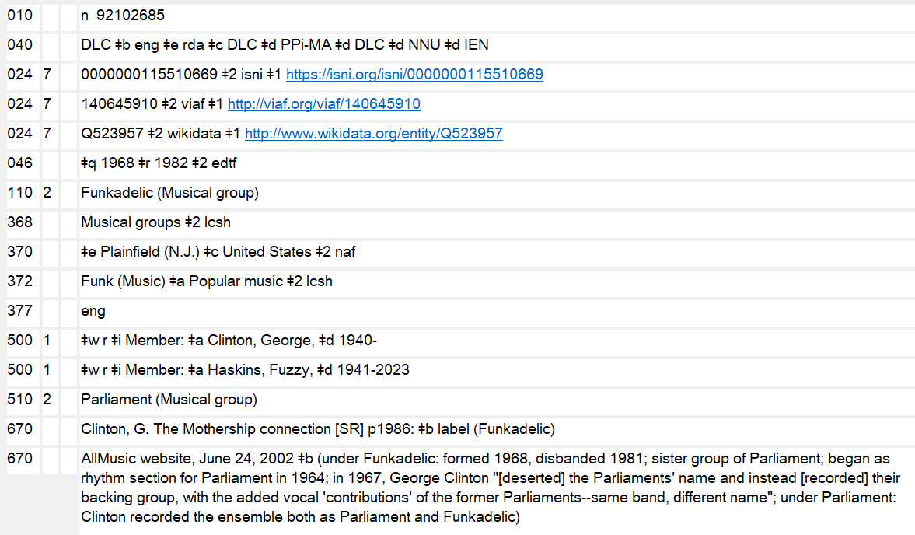
Identifiers
Module 4. Describing Corporate Bodies
83
Notes:
October 7, 2024: replaced screen image with correct form of ISNI URI and 046 subfields $q and $r instead of $s and $t
March 4, 2020: updated screen image to show URIs in 024

Slide 87
Constructing the Authorized Access Point (RDA 11.13)
1. Record the Preferred name in subfield $a of the 110 or 111 field
110 2_ Kurt Weill Foundation for Music
2. Make required additions
  Names not indicating a corporate body (RDA 11.13.1.1)
110 2 _ Johann Traeg (Firm)
Module 4. Describing Corporate Bodies
87
Notes:
March 20, 2017: reformatted slide, updated RDA instruction number and speaker notes
Make additions to the name as instructed at 11.13.1.2–11.13.1.8, as applicable.
If the preferred name for the body does not convey the idea of a corporate body, add the type of corporate body or other designation. Record the designation in a language preferred by the agency creating the data (LC/PCC practice is to record it in English). Includes terms like Firm, Organization, Musical group, Spacecraft, Conference, Project, Program, Television station, etc.
Type of corporate body can also be used to distinguish.

Slide 88
Constructing the Authorized Access Point (RDA 11.13)
3. Make other additions as needed to distinguish between bodies with the same name. Choose qualifier using judgment.
  Place associated with the corporate body (RDA 11.13.1.3)
    110 2_ Constitution Party (U.S.)
  Associated institution (RDA 11.13.1.4)
      110 2_ National Portrait Gallery (Smithsonian Institution)
Module 4. Describing Corporate Bodies
88
Notes:
February 18, 2015
Note that United States is abbreviated to U.S. as the instructions on recording place names point us to the short list of abbreviations in Appendix B.11.
If using associated institution, use the preferred name for the institution, not the authorized access point form. As of February 2015, if you add an associated institution to the authorized access point for a corporate body, it is not necessary to establish a NAR for the associated institution, if a NAR does not exist. However, this policy is currently under consideration for possible change.
88

Slide 89
Constructing the Authorized Access Point (RDA 11.13)
3. Make other additions as needed to distinguish between bodies with the same name. Choose qualifier using judgment.
  Date associated with the corporate body (RDA 11.13.1.5)
    110 2_ Constitution Party (U.S. : 1952-1968)
  Type of jurisdiction (RDA 11.13.1.6)
151 Cork (Ireland : County)
  Other designation (RDA 11.13.1.7)
    111 2_ World Cup (Soccer)
Module 4. Describing Corporate Bodies
89
Notes:
89
February 24, 2014
Type of jurisdiction (RDA 11.13.1.6) is covered in more detail in the module on Places.

Slide 90
Conferences
Preferred name (RDA 11.2.2.5.4)
  Choose the form that includes the name of the associated body
  111 2_ FAO Technical Meeting on Coffee Production and Protection
  Unless it would be recorded subordinately – RDA 11.2.2.14.6
  110 2_ Hawaii Macadamia Nut Association. $b Annual Meeting
  Include frequency term if part of name
Module 4. Describing Corporate Bodies
90
Notes:
March 20, 2017: updated instruction number
In most cases, choose the form including the name of the sponsoring body. If different forms of a conference’s name appear in the preferred source of information, choose a form of the name that includes the name (or abbreviation of the name) of the associated body.
Do not apply this instruction for a conference that is recorded as subordinate to the name of a body associated with the conference (e.g., the annual meeting of an association). Apply instead the instructions at 11.2.2.14.6.
Unlike AACR2, RDA instructs to include the frequency term (e.g. annual) if it is part of the name.

Slide 91
Conferences
11.2.2.11. Omit from the name of a conference, congress, meeting, exhibition, fair, festival, etc., (including that of a conference, etc., treated as a subordinate body, see 11.2.2.14.6), indications of its number, or year or years of convocation, etc.
Calcutta Film Festival
not 4th Calcutta Film Festival
Module 4. Describing Corporate Bodies
91
Notes:
March 20, 2017: updated RDA instruction number

Slide 92
Conferences
MARC:
Code meeting names in 111 unless they are established subordinately to another body. In that case, use 110 or 111 as appropriate. Give the authorized access point of the higher body in subfield $a and the preferred name of the subordinate conference in subfield $b (if 110) or $e (if 111).
111 2_ Annual Meeting on Oncogenes
110 2_ African Studies Association. $b Annual Meeting
111 2_ United Nations Conference on Science and Technology for Development $d (1979 : $c Vienna, Austria). $e Regional Preparatory Meeting
Module 4. Describing Corporate Bodies
92
Notes:
December 9, 2019: added examples to slide
March 20, 2017: previously slide 71
Although it is most common to have conferences that are subordinate to a corporate body, which would be coded 110 with the subordinate conference coded in $b, there can be situations in which a conference is subordinate to another conference. In these unusual cases, the higher body would be coded 111, with the subordinate conference coded $e. For example:
111 2_ United Nations Conference on Science and Technology for Development $d (1979 : $c Vienna, Austria). $e Regional Preparatory Meeting
111 2_ Conference on Security and Cooperation in Europe. $e Follow-up Meeting
111 2_ International Economic History Congress $n (12th : $d 1998 : $c Madrid, Spain). $e Session C.8
111 2_ LISHEP (Conference) $d (2018 : $c Salvador, Brazil). $e Session C

Slide 93
Conferences
Ongoing conferences (LC-PCC PS 11.13.1.8)
For monographic cataloging, create an authority record for each instance
  May create separate authority records for the collective conference and individual instances of an ongoing conference
  Make the connections for earlier and later names of the conference in the collective records, not records for the individual conference
Module 4. Describing Corporate Bodies
93
Notes:
March 20, 2017: updated to reflect LC-PCC PS not RDA
Treatment of ongoing conferences differs for monographic vs. continuing resources cataloging. For monographic cataloging, an authority record should be made for each individual instance of the conference cataloged. For continuing resources cataloging, a collective authority record should be made for the ongoing conference.
LC-PCC PS 11.13.1.8
This PS contains the instructions for how to deal with conferences whose name changes. Earlier and later forms of the names are linked through 5xx fields in the collective authority record. While collective authority records are not always required, a record for the collective conference should always be made to connect the earlier and later names of the collective conference.
A 667 field is created to alert the user to related access points.

Slide 94
Conferences
111 2_ Pacific Rim Conference on Ceramic and Glass Technology
511 2_ $w r $i Successor: $a International Meeting of Pacific Rim Ceramic Societies
667 See also related access points for individual instances of this conference which include specific information about the number, date, or place of the individual conference.
Module 4. Describing Corporate Bodies
94
Notes:
September 17, 2018: moved $w to beginning of 511 field
Here’s an example of a conference that changed its name. A corresponding authority record must be made for the authorized access point in the 5xx field, which will be the 1xx of the related record. Always add the note in the 667 field when there are authority records for both collective and individual instances of an ongoing conference.

Slide 95
Conferences
Single instance of a conference (RDA 11.13.1.8.1)
Add the following elements to the name of a one-time conference, etc., if applicable and readily ascertainable. Add them in this order:
the number of the conference, etc. (see 11.6) in $n
the date of the conference, etc. (see 11.4.2) in $d
the location of the conference, etc. (see 11.3.2) in $c
Recording the number (RDA 11.6.1)
use 1st, 2nd, 3rd, 4th, etc.
Module 4. Describing Corporate Bodies
95
Notes:
August 23, 2023: updated to show use of subfield $q/$r in 046 field
February 30, 2020: added subfield codes to slide; added note about $c repeatability
When constructing an authorized access point for a one-time conference or a single instance of a series of conferences, add the following elements to the name if applicable and readily ascertainable:
a) The number of the conference (see RDA 11.6) – $n in 110, 111, 410, 411, 510, 511
b) The date of the conference (see RDA 11.4.2) – $d in 110, 111, 410, 411, 510, 511; also record in 046 $s and $t – see MARC Authority 046 Subfield Values for Corporate Bodies and Conferences
c) The location of the conference (see RDA 11.3.2) – $c in 110, 111, 410, 411, 510, 511; use repeatable $c for conferences held in more than one place; also record in 370 $e if a place or 373 $a if an associated institution
The location of the conference may be the name of a place or an associated institution if the associated institution provides better identification or the place is unknown.
Note: you can record BOTH the place and the associated institution as elements -- it’s only in the authorized access point that you have to make a choice.
LC-PCC PS 11.6.1.3: Use the form 1st, 2nd, 3rd, etc., for the English ordinal numeral in the addition to an access point for a conference, etc.

Slide 96
Conferences
Single instance of a conference (RDA 11.13.1.8.1)
If held in more than one place:
  a) Include each place in separate $c; separate places with semicolons
  Symposium on Breeding and Machine Harvesting of Rubus and Ribes $d (1976 : $c East Malling, England; $c Dundee, Scotland)
  b) Include only name of the place or places primarily associated with the conference, etc. (e.g., a host city) or name of the larger place or places in which the conference, etc. was held
  Olympic Winter Games $n (21st : $d 2010 : $c Vancouver, B.C.)
  Tour de France (Bicycle race) $d (1970 : $c France; $c Belgium; $c Germany)
or
Module 4. Describing Corporate Bodies
96
Notes:
February 30, 2020: new slide
If a conference, etc. is held in more than one place, RDA 11.13.1.8.1 says to either:
a) Include each place in the access point, separating them by semicolons. As of March 2020, each place is recorded in a separate subfield $c.
or
b) Include on the name of the place or places primarily associated with the conference, etc. (e.g., a host city) or include the name of the larger place or places where the conference, etc. was held. If multiple places are included, separate them by semicolons and record each in a separate subfield $c.
Change records to match the above practice when an NAR is needed for cataloging. This will include records created under AACR2 in which places were separated by the word “and”, as well as RDA records created prior to March 2020 when subfield $c was not repeatable.
Note that associated institution(s) can be recorded instead of places if the name of an associated institution provides better identification than the place name, or the place name or names are not known, or the place name or names cannot be readily determined (RDA 11.13.1.8.1 First Exception).

Slide 97
Exercise:
What are the authorized access points for collective and individual meetings?
181st Semiannual General Conference of The Church of Jesus Christ of Latter-day Saints, October 1-2, 2011
  Collective
  110 2_ Church of Jesus Christ of Latter-day Saints. $b Semiannual General Conference
  Individual
  110 2_ Church of Jesus Christ of Latter-day Saints. $b Semiannual General Conference $n (181st : $d 2011)
Module 4. Describing Corporate Bodies
97
Notes:
December 9, 2019: revised instructor note
March 20, 2017: revised exercise to give authorized access points for collective and individual
conference not just preferred name, each exercise was moved to its own slide for clarity
Instructor Note: Answers appear on clicks. Advise trainees not to look at their manuals, which
will have the answers in the PDF of the slides

Slide 98
Exercise:
What are the authorized access points for collective and individual meetings?
Seventh Annual Global Conference on Pharmaceutical Microbiology, October 22-23, 2012 (held in Bethesda, Maryland)
  Collective
  111 2_ Annual Global Conference on Pharmaceutical Microbiology
  Individual
  111 2_ Annual Global Conference on Pharmaceutical Microbiology $n (7th : $d 2012 : $c Bethesda, Md.)
Module 4. Describing Corporate Bodies
98
Notes:
December 9, 2019: spelled out Maryland in slide to illustrate that the abbreviation of the larger
place is used in the access point
Instructor Note: Answers appear on clicks. Ask trainees to watch the screen rather than look
at their handout (which will have the answers).

Slide 99
Exercise:
What are the authorized access points for collective and individual meetings?
The 13th International Symposium on Online Journalism (held at the Blanton Museum of Art)
  Collective
  111 2_ International Symposium on Online Journalism
  Individual
  111 2_ International Symposium on Online Journalism $n (13th : $c Blanton Museum of Art)
Module 4. Describing Corporate Bodies
99
Notes:
March 7, 2019: revised instructor note
Instructor Note: Answers appear on clicks. Ask trainees to watch the screen rather than look
at their handout (which will have the answers).

Slide 100
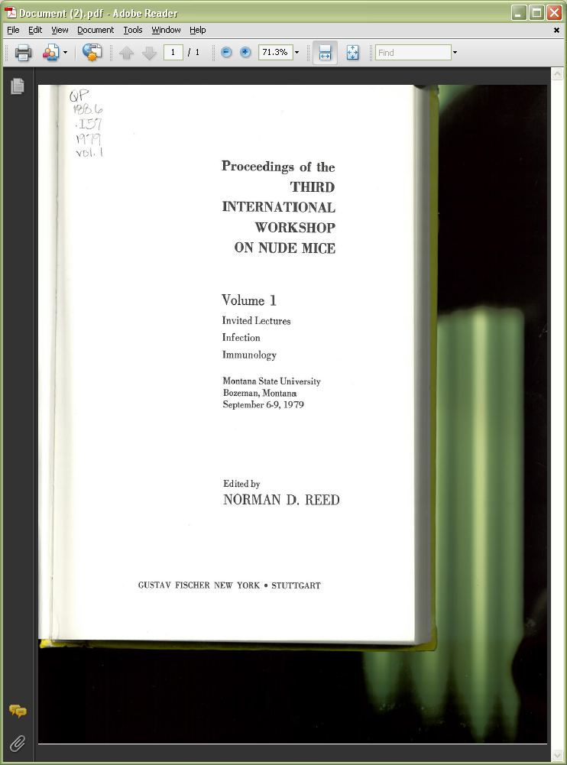
Exercise: Conferences
Module 4. Describing Corporate Bodies
100
Notes:
March 7, 2019: revised instructor note
Instructor Note: Answers appear on clicks. Ask trainees to watch the screen rather than look at their handout (which will have the answers).
Record the preferred name of this meeting.
Preferred name:
111 2_ International Workshop on Nude Mice
Authorized access point:
111 2_ International Workshop on Nude Mice $n (3rd : $d 1979 : $c Bozeman, Mont.)
or
111 2_ International Workshop on Nude Mice $n (3rd : $d 1979 : $c Montana State University)
but not
111 2_ International Workshop on Nude Mice $n (3rd : $d 1979 : $c Montana State University (Bozeman, Mont.))
If giving an associated institution for the location, use the preferred name for the body, not the authorized access point (see LC-PCC PS 11.13.1.8.1 and RDA 11.5.1.3).

Slide 101
Frontiers of Combining Systems
FroCoS Proceedings
1996-2016
Franz Baader and Klaus U. Schulz, Editors
Applied Logic Series, Vol. 3
Kluwer Academic Publishers
Dordrecht
1996
Module 4. Describing Corporate Bodies
101
Notes:
March 7, 2019: revised note about trainees
Instructor Note: Answers appear on clicks. Ask trainees to watch the screen rather than look at their handout (which will have the answers).
LC-PCC PS 11.13.1.2:
Initialisms and Acronyms
LC practice/PCC practice: If the name chosen for the authorized access point for a corporate body is an initialism or acronym written in all capital letters (with or without periods between them), add a Type of corporate body qualifier to the name. Alternatively, a spelled out form of the name may be used as an Other designation addition if such an addition better identifies the corporate body.
Although the presentation of the acronym does not routinely use capital letters, the intent of the LC-PCC PS can be applied in this situation.
LC-PCC PS 11.13.1.8:
Authority Records for Ongoing Conferences
LC practice/PCC practice: For ongoing conferences, separate authority records may be created for the collective conference (typically made when cataloging a serial), an individual instance of an ongoing conference (typically made when cataloging a monograph), or both. These records may coexist in the LC/NACO authority file. A record for the collective conference should always be made to connect the earlier and later names of the collective conference.
Record the preferred name of this meeting.
Preferred name:
111 2_ FroCoS
Authorized access point:
111 2_ FroCoS (Symposium)
or
111 2_ FroCoS (Frontiers of Combining Systems)

Slide 102

Module 4. Describing Corporate Bodies
102
Notes:
March 7, 2019: revised note about trainees
Instructor Note: Answers appear on clicks. Ask trainees to watch the screen rather than look at their handout (which will have the answers).
LC-PCC PS 11.13.1.2:
Initialisms and Acronyms
LC practice/PCC practice: If the name chosen for the authorized access point for a corporate body is an initialism or acronym written in all capital letters (with or without periods between them), add a Type of corporate body qualifier to the name. Alternatively, a spelled out form of the name may be used as an Other designation addition if such an addition better identifies the corporate body.
Although the presentation of the acronym does not routinely use capital letters, the intent of the LC-PCC PS can be applied in this situation.
LC-PCC PS 11.13.1.8:
Authority Records for Ongoing Conferences
LC practice/PCC practice: For ongoing conferences, separate authority records may be created for the collective conference (typically made when cataloging a serial), an individual instance of an ongoing conference (typically made when cataloging a monograph), or both. These records may coexist in the LC/NACO authority file. A record for the collective conference should always be made to connect the earlier and later names of the collective conference.
Record the preferred name of this meeting.
Preferred name:
111 2_ FroCoS
Authorized access point:
111 2_ FroCoS (Symposium)
or
111 2_ FroCoS (Frontiers of Combining Systems)

Slide 103
Things to Remember about Conferences
When to create collective conference records
Include frequency when part of the name
Add place unless institution identifies better (but both may be recorded as elements)
Module 4. Describing Corporate Bodies
103
Notes:
May 1, 2013
Collective authority records are created for a conference when the resource being cataloged is a continuing resource. Conference name changes may also be recorded in collective authority records.
Remember, many elements may be recorded in the authority record which may not be added to the authorized access point. These elements can be useful information helping the user to identify the entity.

Slide 104
Variant Names (RDA 11.2.3)
Variants can occur for corporate names as they do for other types of names
Record variant names:
  Used by the corporate body
  Found in reference sources
  Resulting from a different transliteration of the name
Module 4. Describing Corporate Bodies
104
Notes:
104
May 1, 2013
Variant names are not considered core, but a cataloger should record them if s/he thinks they will help the user of the database; use cataloger’s judgment!

Slide 105
Variant Names (RDA 11.2.3)
    110 2_ Museo del Prado
    410 2_ Prado Museum
    410 2_ Museo Nacional del Prado
    410 2_ Museo Nacional de Pintura y Escultura (Spain)
    410 2_ Musée du Prado
    410 2_ 프라도 미술관
    410 2_ P'ŭrado Misulgwan
    410 2_ Национальный музей Прадо
    410 2_ Nat︠s︡ionalʹnyĭ muzeĭ Prado
    410 2_ Музей Прадо
    410 2_ Muzeĭ Prado
    410 2_ 普拉多博物馆
    410 2_ Puladuo bo wu guan
    410 2_ Puladuo bowuguan
Module 4. Describing Corporate Bodies
105
Notes:
105
December 9, 2019

Slide 106
Variant Names (RDA 11.2.3)
Record variant names:
  For a direct form of the name if the preferred name is recorded as a subdivision of a higher or related body.
    110 2_ Smithsonian Institution. $b Center for Folklife and Cultural Heritage
    410 2_ Center for Folklife and Cultural Heritage (Smithsonian Institution)
Module 4. Describing Corporate Bodies
106
Notes:
May 1, 2013
Record variants only if the name might reasonably be searched in that variant form.
Apply the specific instructions at 11.2.3.4–11.2.3.7 and 11.2.2.5–11.2.2.31, as applicable. These deal with acronyms and initials in names, alternative linguistic forms, different spellings; fuller, shorter or inverted names, etc.
106

Slide 107
Variant Names (RDA 11.2.3)
Record variant names:
  For the name as a subdivision of a higher or related body if the preferred name is recorded in direct form
      110 2_ National Portrait Gallery (Smithsonian Institution)
      410 2_ Smithsonian Institution. $b National Portrait Gallery
Module 4. Describing Corporate Bodies
107
Notes:
May 1, 2013
Record variants only if the name might reasonably be searched in that variant form.
Apply the specific instructions at 11.2.3.4–11.2.3.7 and 11.2.2.5–11.2.2.31, as applicable. These deal with acronyms and initials in names, alternative linguistic forms, different spellings; fuller, shorter or inverted names, etc.
107

Slide 108
Variant Names (RDA 11.2.3)
Variant names are recorded in a MARC 410 or 411 field
    110 2_ United Nations
    410 2_ U.N.
    410 2_ UNO
    410 2_ Naciones Unidas
    410 2_ سازمان ملل متحد
    410 2_ Организация Объединённых Наций
etc. ...
Module 4. Describing Corporate Bodies
108
Notes:
108
March 20, 2017: removed instruction to record in $a: a variant name recorded as a subdivision of a higher or related body will be recorded in $a and $b.
If the name recorded as the preferred name for a corporate body has one or more alternative linguistic forms, record them as variant names (RDA 11.2.3.6).

Slide 109
Variant Names (RDA 11.2.3)
Other possible variant names:
Expanded name
  110 2_ Euratom
    410 2_ European Atomic Energy Community
Abbreviated form
    110 2_ European Economic Community
      410 2_ EEC
Module 4. Describing Corporate Bodies
109
Notes:
109
May 1, 2013
Record other variant names and variant forms of the name not covered by 11.2.3.4-11.2.3.6, if considered important for identification or access. (RDA 11.2.3.7)

Slide 110
Variant Names (RDA 11.2.3)
Other possible variant names:
  Symbols and numbers
    110 2_ Third & Elm Press
    410 2_ 3rd & Elm Press
    410 2_ Third and Elm Press
  Shortened forms
  110 2_ Betty Shaw & Associates
  410 2_ Shaw & Associates
  410 2_ Betty Shaw and Associates
  410 2_ Shaw and Associates (Jonesboro, Ark.)
Module 4. Describing Corporate Bodies
110
Notes:
110
December 9, 2019: replaced example G.M. Johnson & Associates Ltd. because inclusion of “Ltd.” in preferred name is questionable.
In the third 410 of the second example, a qualifier was added to break a conflict with a different firm with the same variant name.

Slide 111
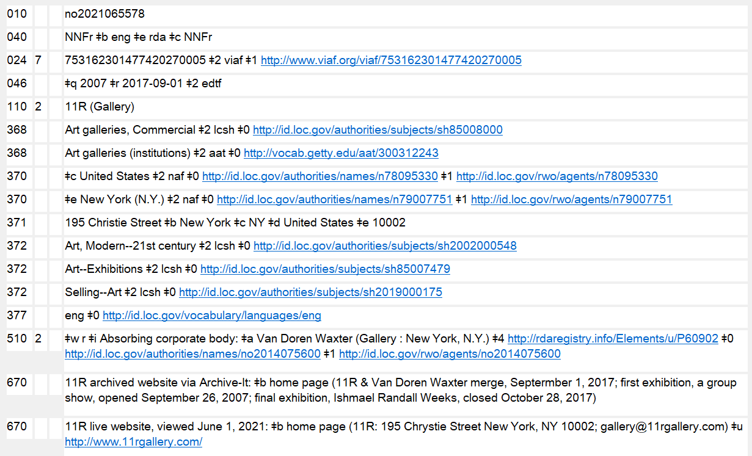
URIs in 3XX and 5XX
Notes:
July 30, 2025: updated speaker notes
October 7, 2024: new slide
URIs may be added to 3XX and 5XX fields in accordance with PCC guidelines and best practices. Tools such as the Authority Toolkit (https://files.library.northwestern.edu/public/oclc/documentation/) may be used to automatically add URI subfields. Record authority record URIs in subfield $0, real world object URIs in $1, and relationship designator URIs in $4. The recommended order of subfields is $2 $4 $0 $1. When using RDA relationship URIs in $4, use unconstrained property URIs from the RDA Registry (https://www.rdaregistry.info/Elements/u/). Consult the URIs in MARC Pilot Resource Documents & Tools website (https://wiki.lyrasis.org/pages/viewpage.action?pageId=178881300), but note that PCC documentation on URIs is currently in the process of being revised and updated.
URIs were originally added as part of the PCC’s URIs in MARC Pilot project. The 667 note “URIs added to this record for the PCC URI MARC Pilot. Please do not remove or edit the URIs” is no longer required and may be deleted when a record is being revised for any reason.
Reminder: Any authorized access point given in a 5XX field must be established in its own authority record.
$0 - authority URI
$1 - real world object URI
$4 - relationship URI

Slide 112
Related Persons (RDA 30)
Related persons are recorded in 500 fields. If one is available, include a relationship designator in subfield $i (from RDA Appendix K), with $w r.
110 2_ Miles Davis Quintet
500 1_ $w r $i Founder: $a Davis, Miles
Module 4. Describing Corporate Bodies
112
Notes:
September 17, 2018: moved $w to beginning of 500 field

Slide 113
Related Families (RDA 31)
Related families are also recorded in 500 fields. If one is available, include a relationship designator in subfield $i (from RDA Appendix K), with $w r.
  110 2_ San Francisco Coffee Company
  500 3_ $w r $i Founding family: $a Larizadeh (Family)
  100 3_ Larizadeh (Family)
  510 2_ $w r $i Founded corporate body of family: $a San Francisco Coffee Company
Module 4. Describing Corporate Bodies
113
Notes:
September 17, 2018: moved $w to beginning of 500 and 510 fields
113

Slide 114
Related Corporate Bodies (RDA 32)
Related corporate bodies are recorded in 510 fields. If one is available, include a relationship designator in subfield $i (from RDA Appendix K), with $w r.
  110 2_ Verizon
  510 2_ $w r $i Component of merger: $a Bell Atlantic Corporation
  510 2_ $w r $i Component of merger: $a GTE Corporation
Module 4. Describing Corporate Bodies
114
Notes:
114
September 17, 2018: moved $w to beginning of 510 field
September 12, 2017: changed relationship designator to Component of merger (was, incorrectly, Mergee)

Slide 115
Special Situations: LC-PCC PS 32.1.1.3
Earlier name resumed
  Treat each instance of the name as a separate body, with these exceptions:
    Type likely to be subject to frequent name changes
    Place names
      Saint Petersburg (Russia) > Petrograd (R.S.F.S.R.) > Leningrad (R.S.F.S.R.) > Saint Petersburg (Russia)
    Bodies with complex and uncertain histories
Earlier names not likely to be needed as relationships
  For earlier names that are not likely ever to be needed as access points in bibliographic records, it is permissible not to create separate authority records for these earlier names
Module 4. Describing Corporate Bodies
115
Notes:
115
August 12, 2019
LC-PCC PS for 32.1.1.3 has some very important guidance on what to do when a corporate body resumes an earlier name. It also provides an exemption to the general practice of making authority records for earlier names of a body.
Earlier Name Resumed
When a corporate body resumes an earlier form of name, treat each instance of the name as a separate body, and apply the instructions at Policy Statement 11.13.1.1 to distinguish between authorized access points.
However, when a corporate body belongs to one of the categories listed below, use one authorized access point to represent all instances of the same name, and include a 667 field on the authority record for the resumed name to alert other catalogers that this decision has been made. Include other clarifying information in the 667 note if it is useful.
If a body belonging to one of the categories listed below has already had separate authorized access points created for the earlier and resumed names, it is not required to retrospectively collapse the separate access points into one authorized access point.
A. Bodies of a Type Likely to Be Subject to Frequent Name Changes
When a corporate body is of a type likely to have frequent name changes because of its nature (e.g., firms named after individual members, legislative committees, conferences) use one authorized access point to represent both the earlier and resumed name.
B. Place Names
When a place resumes its earlier name, use the same authorized access point for both the earlier and resumed name provided the additions to the authorized access point are appropriate for each instance (see Policy Statement 11.13.1.6).
C. Bodies with Complex and Uncertain Histories
If a body has had a complex or uncertain history, and creating and applying separate authorized access points for each use of the same name is not feasible, use the same authorized access point for both the earlier and resumed name.
Earlier Names Not Likely to be Needed as Relationships
In some circumstances, research will indicate that the corporate body being established had earlier names that are not likely ever to be needed as access points in bibliographic records. If a decision is made not to create separate authority records for these earlier names, record them in the source citation along with an indication that separate records were not needed, such as "[no publications in LC database]" or "[no access point found in OCLC]."

Slide 116
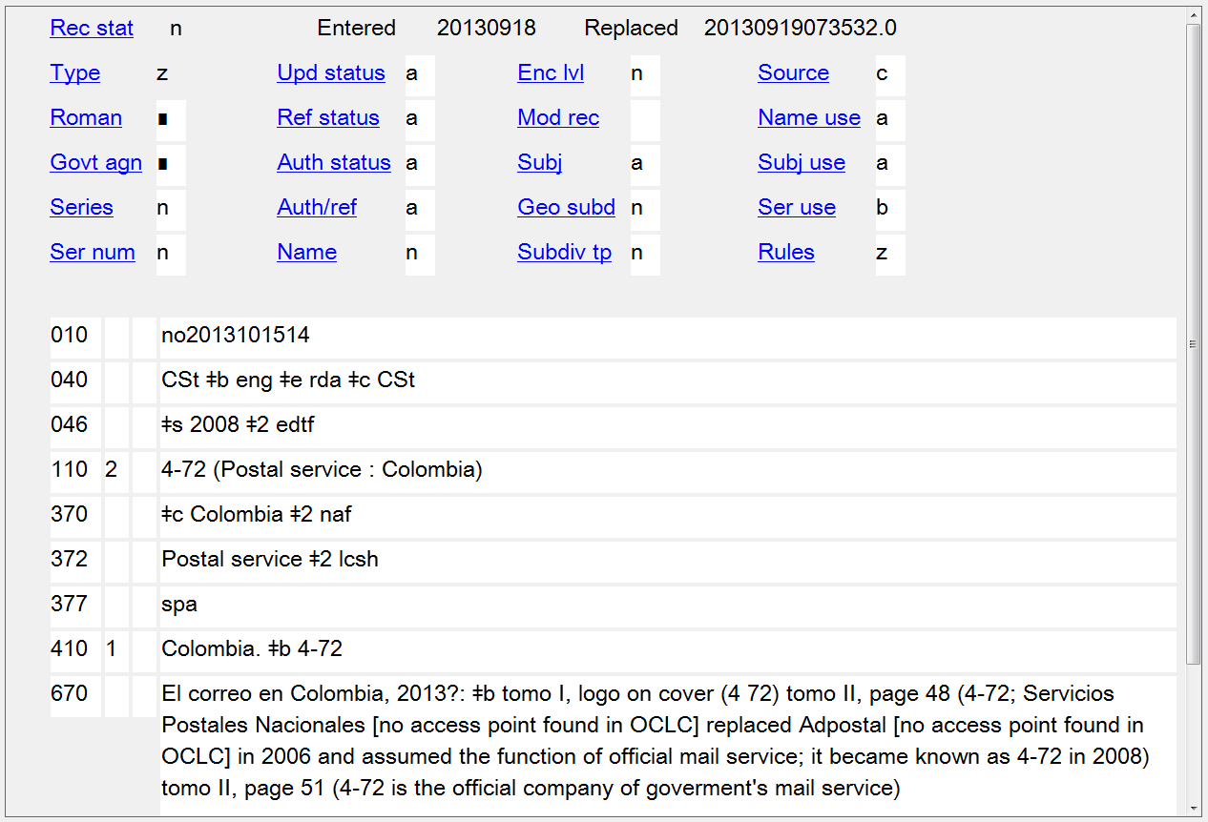
Module 4. Describing Corporate Bodies
116
Notes:
August 12, 2019
Earlier Names Not Likely to be Needed as Relationships
In some circumstances, research will indicate that the corporate body being established had earlier names that are not likely ever to be needed as access points in bibliographic records. If a decision is made not to create separate authority records for these earlier names, record them in the source citation along with an indication that separate records were not needed, such as "[no publications in LC database]" or "[no access point found in OCLC].“
Note: In AACR2 NACO practice, it was permissible to record earlier names that were not likely to be needed as access points in bibliographic records as variant access points in the record for the later name. This is no longer the practice under RDA, so there may be records being reevaluated for RDA where 4XXs should be deleted (or converted into 5XX with a new authority record for the earlier name).
Note: the 046 $s should be changed to $q if this record is being revised for any other reason

Slide 117
Government-designated Parks, Forests, Etc.
Establish headings needed for the geographic entity as subjects tagged 151 through SACO, usually with a geographic qualifier
Establish authorized access points needed for entries for the corporate, administrative entity as a creator or contributor with the qualifier (Agency : [Govt Name]). Use MARC tag 110.
Not limited to U.S. parks, forests, etc.
http://www.loc.gov/catdir/cpso/parks2.html
DCM Z1, App. 1
Module 4. Describing Corporate Bodies
117
Notes:
May 1, 2013; revised June 8, 2017: revised final sentence for clarity
NOTE: Agency is the required qualifier. The name of the government, if applicable, is usually added in addition.
This practice applies not only to national parks and forests, but also to analogous entities such as battlefields, historic sites, lakeshores, memorials, monuments, parkways, recreation areas, rivers, scenic trails, seashores, wild and scenic rivers, as well as entities of any of these types established at the state, provincial, departmental, etc., level.
All government-designated parks, forests, etc., are established according to these rules, both foreign and domestic.

Slide 118
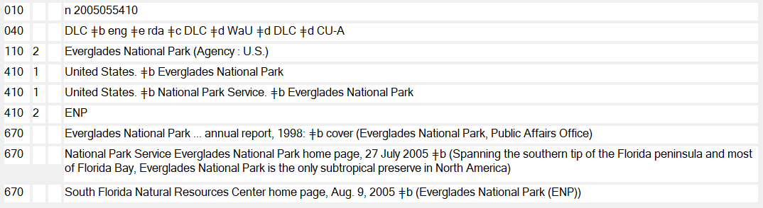
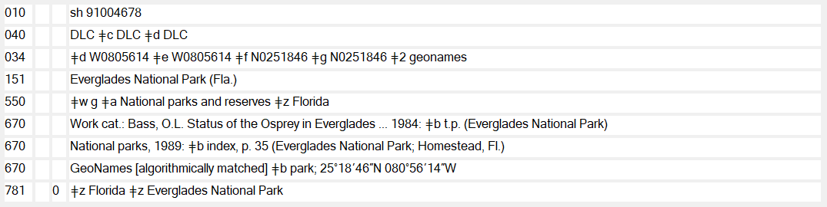
Government-designated Parks, Forests, Etc.
Name heading
Subject heading
Module 4. Describing Corporate Bodies
118
Notes:
September 17, 2018
Note that both have qualifiers, but different types as appropriate to the type of authorized access point.
If you are ever in doubt about what type of authority record you are looking at, look at the 010. If it has n number, then it is a name authority record. If the 010 is sh number, then it is a subject heading.
118

Slide 119
Exercise
Complete the authority records for these corporate bodies:
Butler Institute of American Art
Facultad de Medicina of Universidad Autónoma de San Luis Potosí
Third International Workshop on Nude Mice
Module 4. Describing Corporate Bodies
119
Notes:
August 23, 2023: updated exercise answers to show use of subfield $q/$r in 046 field
March 20, 2017: updated 111 for workshop—use preferred name not authorized access point for associated institution.
Note to Instructor: Suggested answers are given below. Trainees do not have answers for the exercise in their manuals.
Possible answers:
046 $q 1919 $2 edtf $v Masterworks from the Butler Institute of American Art, 2010
110 2_ Butler Institute of American Art
368 Art museums $2 lcsh or Museums $2 lcsh
370 $c United States $e Youngstown (Ohio) $2 naf
371 524 Wick Avenue $b Youngstown $c Ohio $d U.S. $e 44502 $m info@butlerart.com
372 Art, American $2 lcsh
377 eng
670 Butler Institute of American Art webpage, viewed Feb. 2, 2013 $b (The Butler Institute of American Art; 524 Wick Avenue, Youngstown, Ohio 44502; email: info@butlerart.com)
110 2_ Universidad Autónoma de San Luis Potosí. $b Facultad de Medicina
368 Medical colleges $2 lcsh and/or Universities and colleges $2 lcsh
370 $c Mexico $e San Luis Potosí (Mexico) $2 naf
372 Medicine--Study and teaching $2 lcsh
377 spa
410 2 Facultad de Medicina de Universidad Autónoma de San Luis Potosí
Homenaje conmemorativo que la Facultad de Medicina de San Luis Potosi ofrece al poeta Jaime Sabines, 2000: $b t.p. (Universidad Autónoma de San Luis Potosí, Facultad de Medicina)
046 $s 1979-09-06 $t 1979-09-09 $2 edtf
111 2_ International Workshop on Nude Mice $n (3rd : $d 1979 : $c Montana State University)
368 Congresses and conventions $2 lcsh and/or
Conference and/or
368 Workshop and/or
368 Workshops (Adult education) $2 lcsh
370 $c United States $e Bozeman (Mont.) $2 naf
372 $a Nude mouse $2 lcsh or Nude mouse--Congresses $2 lcsh
373 $a Montana State University (Bozeman, Mont.) $2 naf
670 $a Proceedings of the Third International Workshop on Nude Mice, 1979: $b title page (Montana State University, Bozeman, Montana; September 6-9, 1979)
119

Slide 120
Things to Remember
Remember when to add elements to the name
When name changes, establish earlier and later forms
Make distinctions between variant forms of the name and name changes
Module 4. Describing Corporate Bodies
120
Notes:
May 1, 2013
Make additions to the preferred name when:
- The authorized access point does not convey that it is a corporate body
- Name conflicts
- Certain government bodies

